Slide 1
OMMS
SAMPLE DOCUMENT · POWERPOINT
Site proposal
The PowerPoint your client receives with a proposal: one slide per site, with photo, size, lighting, price and availability.
✓ Built from the media catalogue in one click
✓ Size, lighting, monthly price and the date each site is free
✓ A Maps link on every slide
Sample generated by OMMS from demo data. Sable Outdoor Media and every client, vendor, GSTIN, site and amount in it are fictitious.

Slide 2

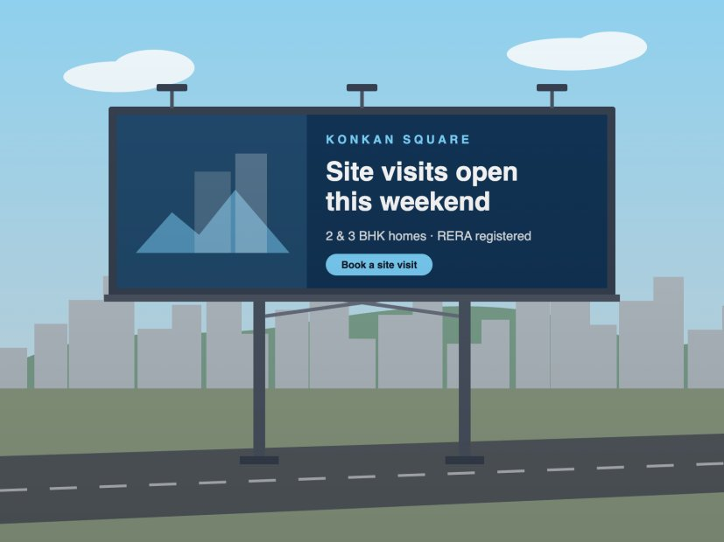

At Lodge Junction, Airoli Facing Kharghar
Maps
| Hoarding | 30x10 (300 sqft) | Non-Lit | Amount - ₹3,45,480.00/- | Available from 01 Nov 2026

Slide 3

Nr. Civil Court, Ulhasnagar Facing Vashi
Maps
| Hoarding | 15x20 (300 sqft) | Lit | Amount - ₹1,72,740.00/- | Available

Slide 4

At Vegetable Market, Bhiwandi Facing Nashik
Maps
| Hoarding | 51x60 (3,060 sqft) | Non-Lit | Amount - ₹51,822.00/- | Available from 01 Nov 2026

Slide 5
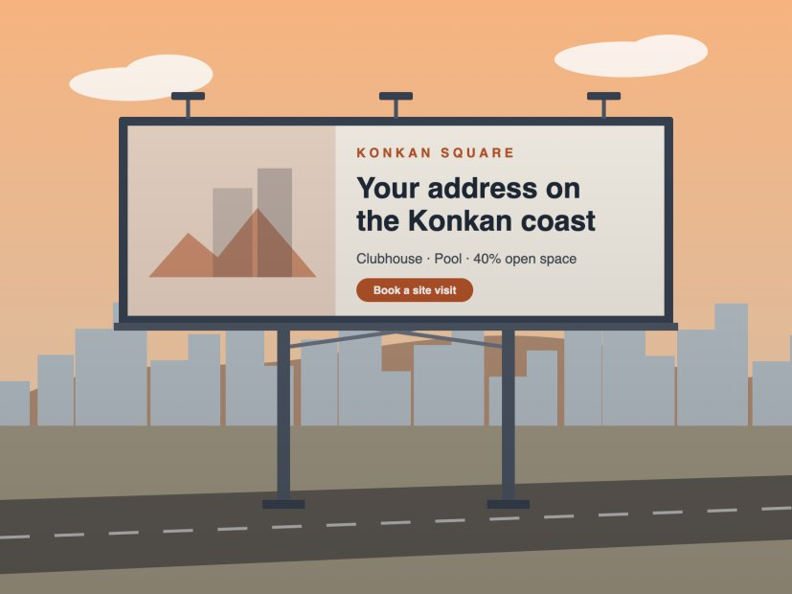
Opp. Swimming Pool, Kharghar Facing Pune
Maps
| Hoarding | 20x20 (400 sqft) | Non-Lit | Amount - ₹43,185.00/- | Available from 01 Nov 2026

Slide 6
OMMS
TALK TO US
Send proposals like this from your own media
In a 30-minute demo we take one site from proposal to campaign, invoice and payment.
Email
rahul@buildnboost.com
Call or WhatsApp
+91 79001 51883
Website
omms-website.vercel.app
Sample generated by OMMS from demo data. Sable Outdoor Media and every client, vendor, GSTIN, site and amount in it are fictitious.

