Slide 1
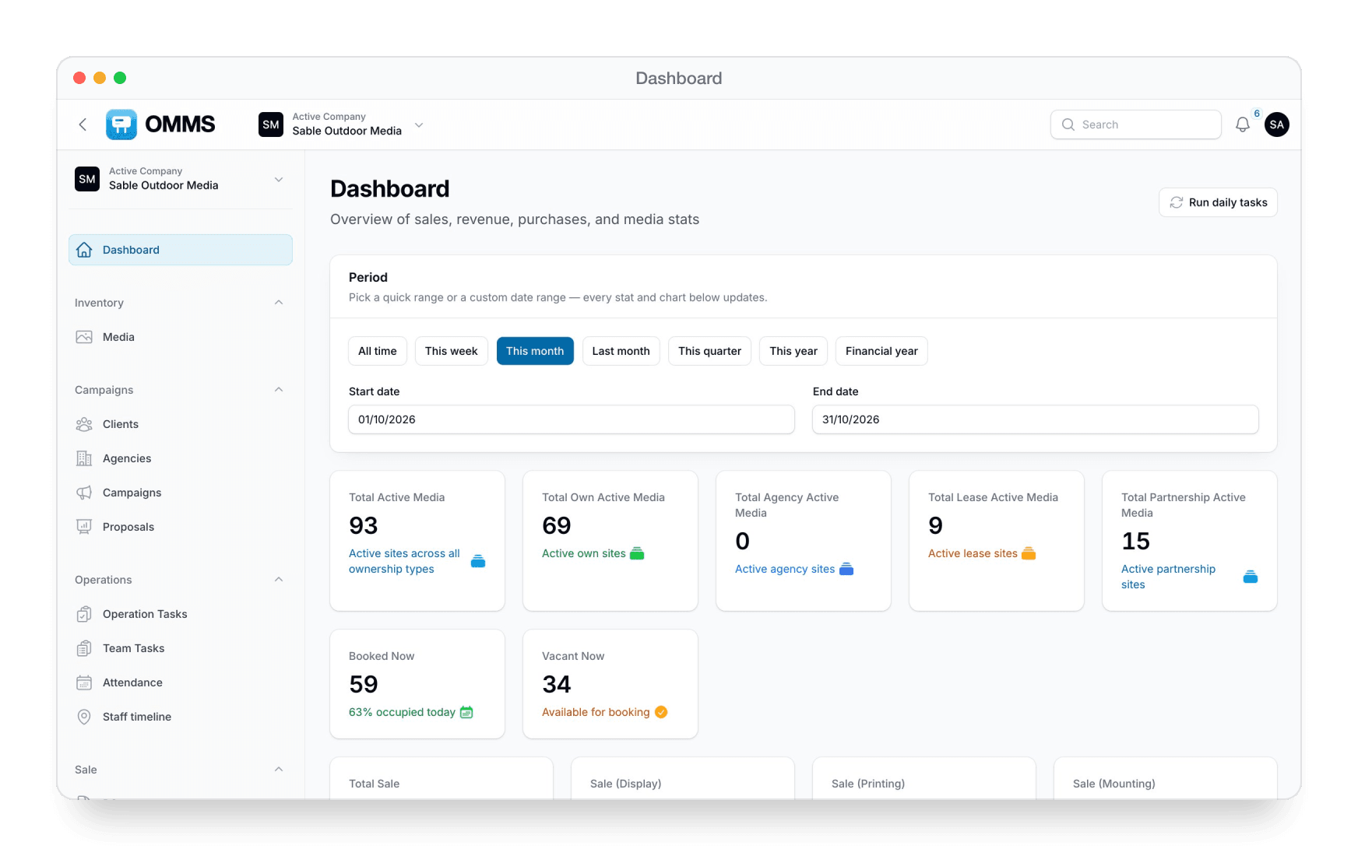
Run your outdoor media business in one place
OUTDOOR MEDIA SOFTWARE
Sites, campaigns, billing, field crews and accounts — for hoarding owners and outdoor media agencies.

Slide 2






What OMMS covers
Office staff use the admin panel, field crews use the mobile app, and clients use the portal.
Inventory & sales
Media, campaigns, proposals, clients and agencies
Billing & collections
Client POs, invoices, proformas, payments and TDS
Purchase & rent
Vendor POs and bills, vendors, landlords and rent
Field operations
Mounting and monitoring tasks, team tasks, attendance and staff timeline
Accounts & reports
Vouchers, ledgers, GST and GSTR-1, P&L and campaign profit
Access & alerts
Mobile app, client portal, roles, notifications and trash

Slide 3
Your business at a glance
DASHBOARD
Any period
This week, this month, this quarter, the financial year or custom dates.
Inventory
Active, own, lease, partnership, booked and vacant sites.
Sales and billing
Totals split by display, printing and mounting.
Charts
Monthly revenue, collections, occupancy and outstanding aging.

Slide 4
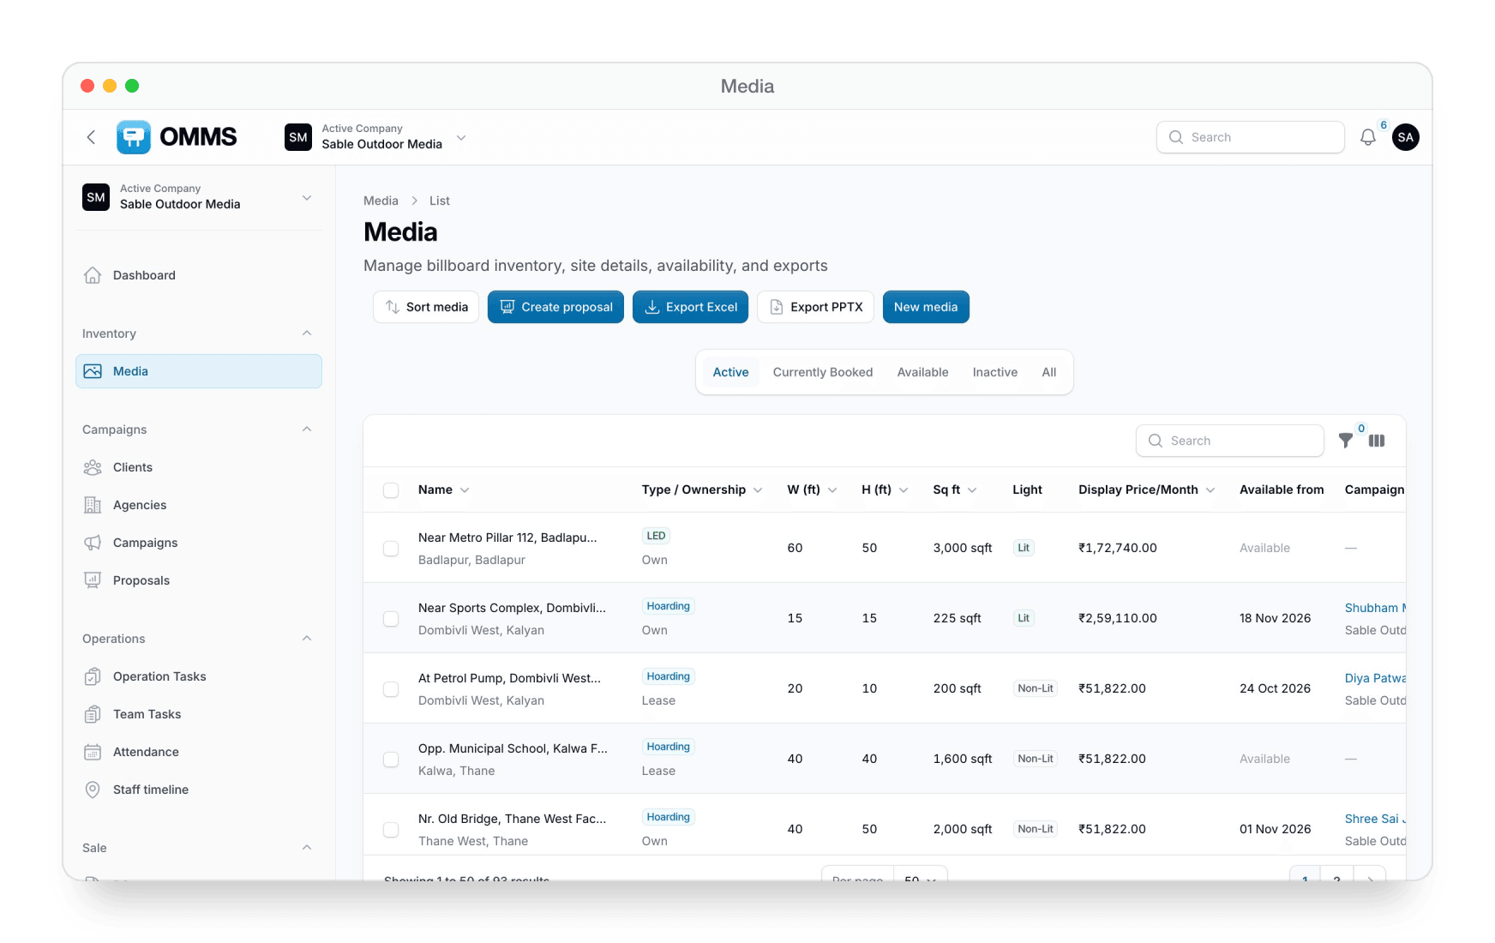
Every site in one catalogue
MEDIA
Site details
Type, ownership, size, lighting, price per month and location.
Status tabs
Active, Currently Booked, Available and Inactive.
Photos and papers
Images, documents and Sort Media for proposal order.
Share across companies
Mirror sites to other companies in your group.
Export
Excel or a client-ready PowerPoint of selected sites.

Slide 5
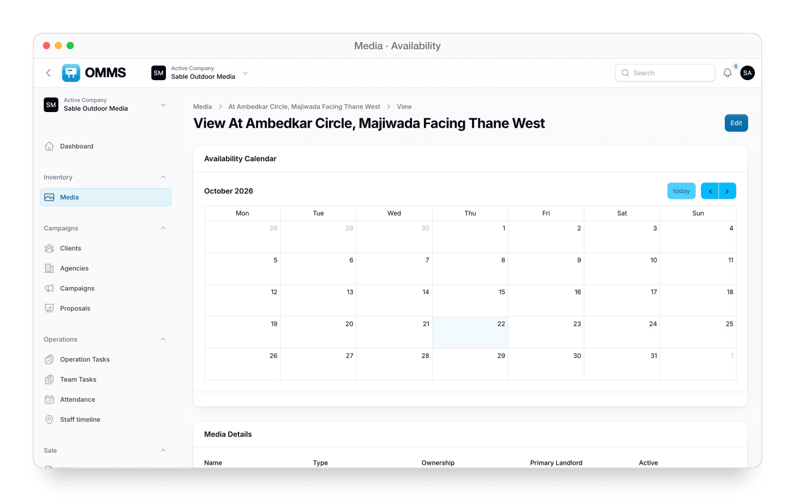
Availability calendar
Each site shows when it is booked and when it is free, before you promise it to a client.

Slide 6
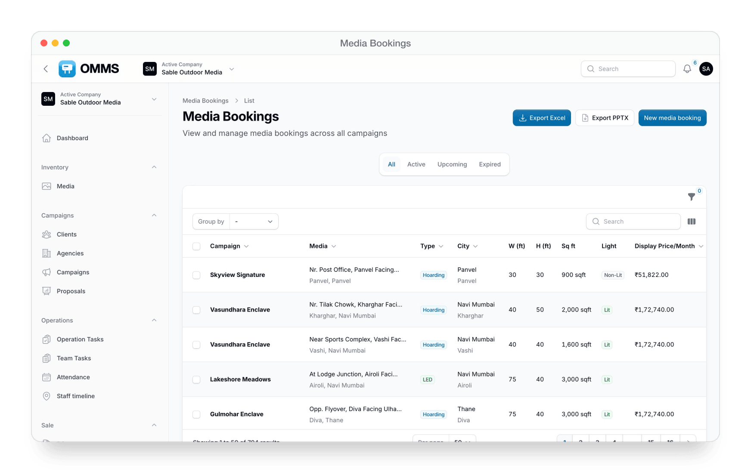
Media Bookings
Every booked site across campaigns, with size, lighting, dates and price — export to Excel or PowerPoint.

Slide 7
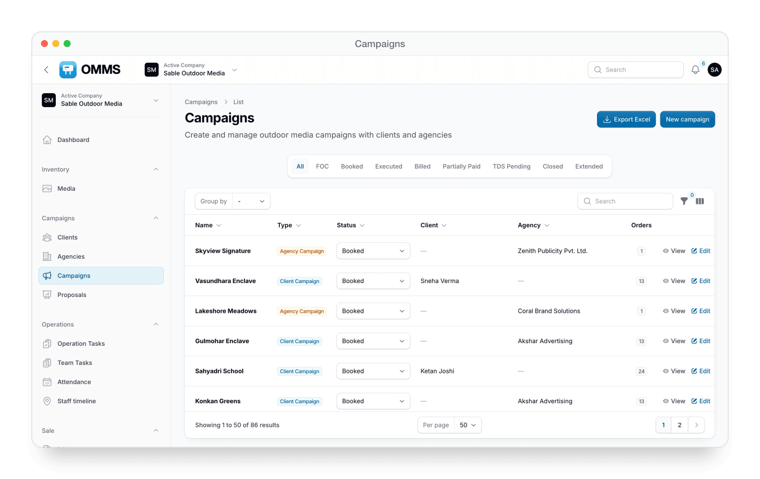
From booking to closed
CAMPAIGNS
Status tabs
FOC, Booked, Executed, Billed, Partially Paid, TDS Pending, Closed and Extended.
Client or agency
Sales owner, credit period, payment mode and commercial terms.
Billing actions
Generate a bill or proforma, split a bill or PO, extend the campaign.
Execution
Print & mount orders, proof photos and a proof PowerPoint.
Exports
Campaign PDF and Excel.

Slide 8
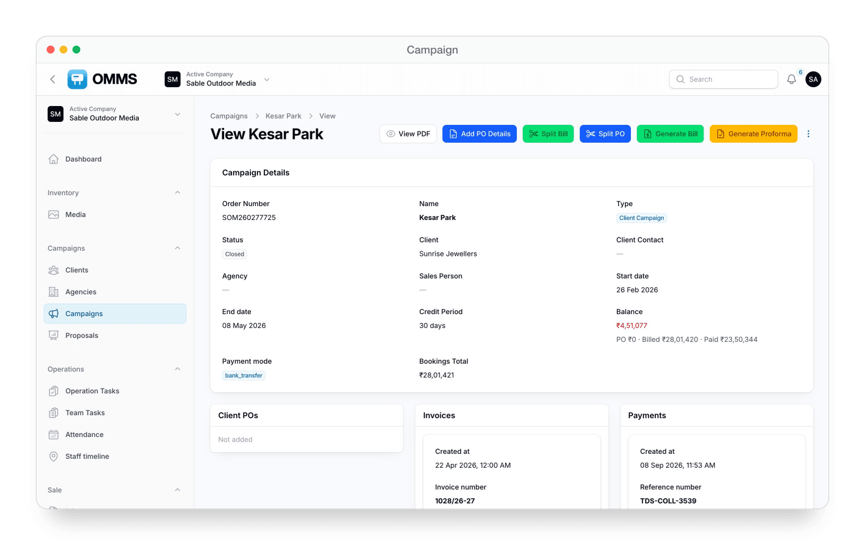
Campaign record
Bookings, client POs, invoices, payments, outstanding, tasks and photos — all on one campaign.

Slide 9
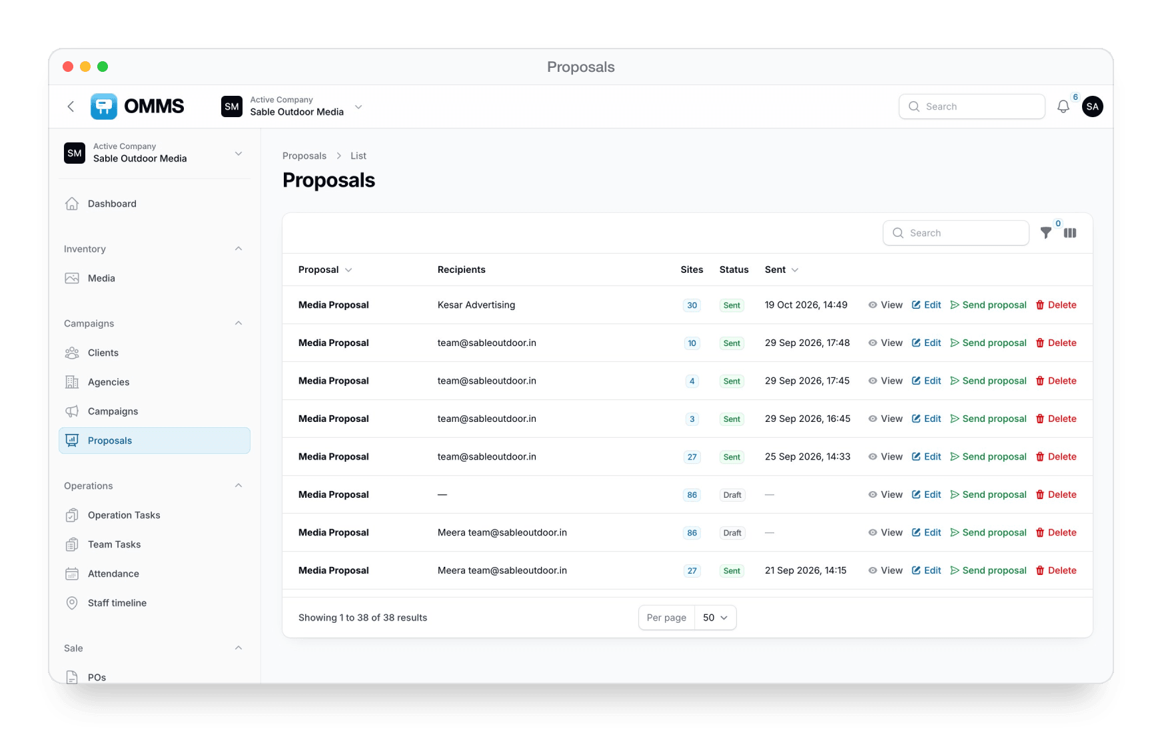
Send site proposals in minutes
PROPOSALS
Build from Media
Select sites in the catalogue and create a proposal.
Send with To, CC and BCC
Clients get Excel and PowerPoint download links.
Track
Draft or sent, recipients, number of sites and sent date.

Slide 10
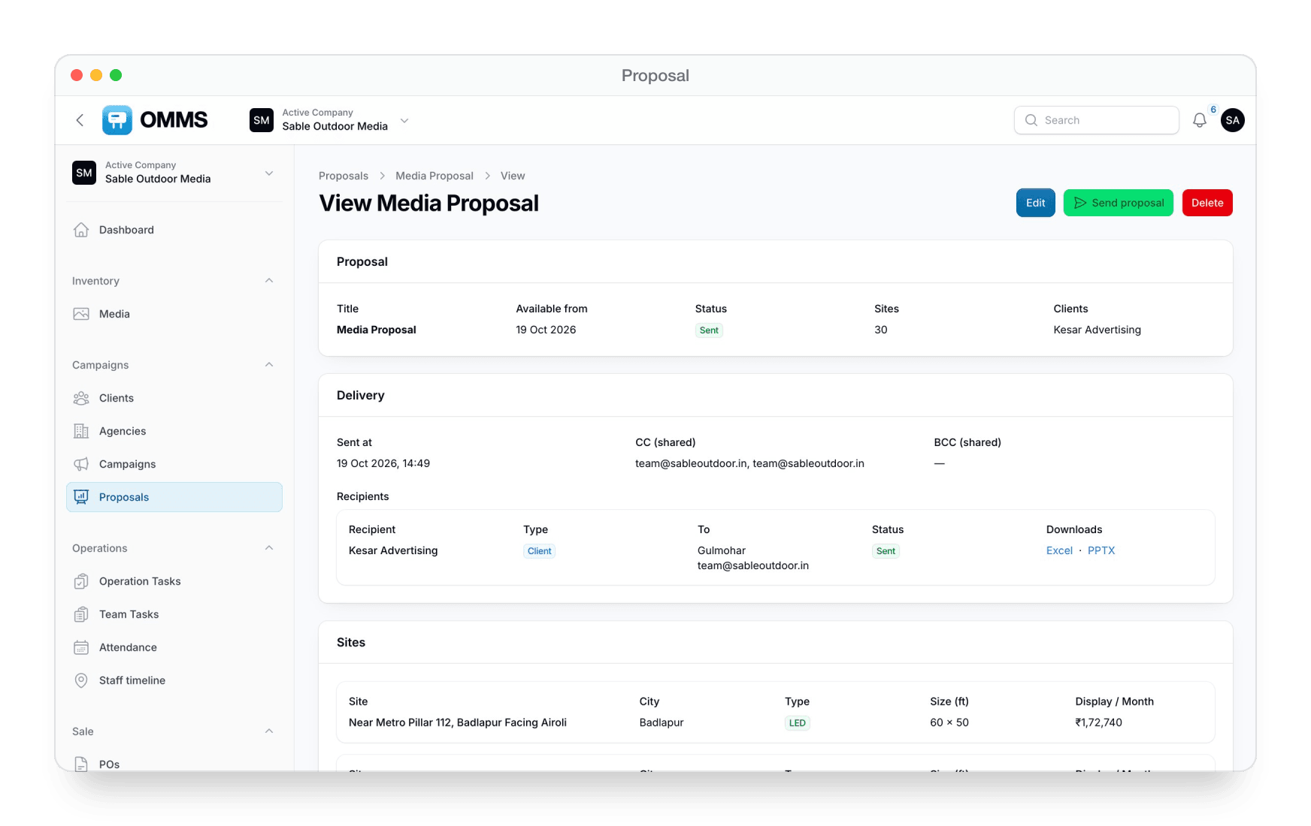
Proposal detail
Who it went to, when, which files they can download, and every site in the proposal.

Slide 11
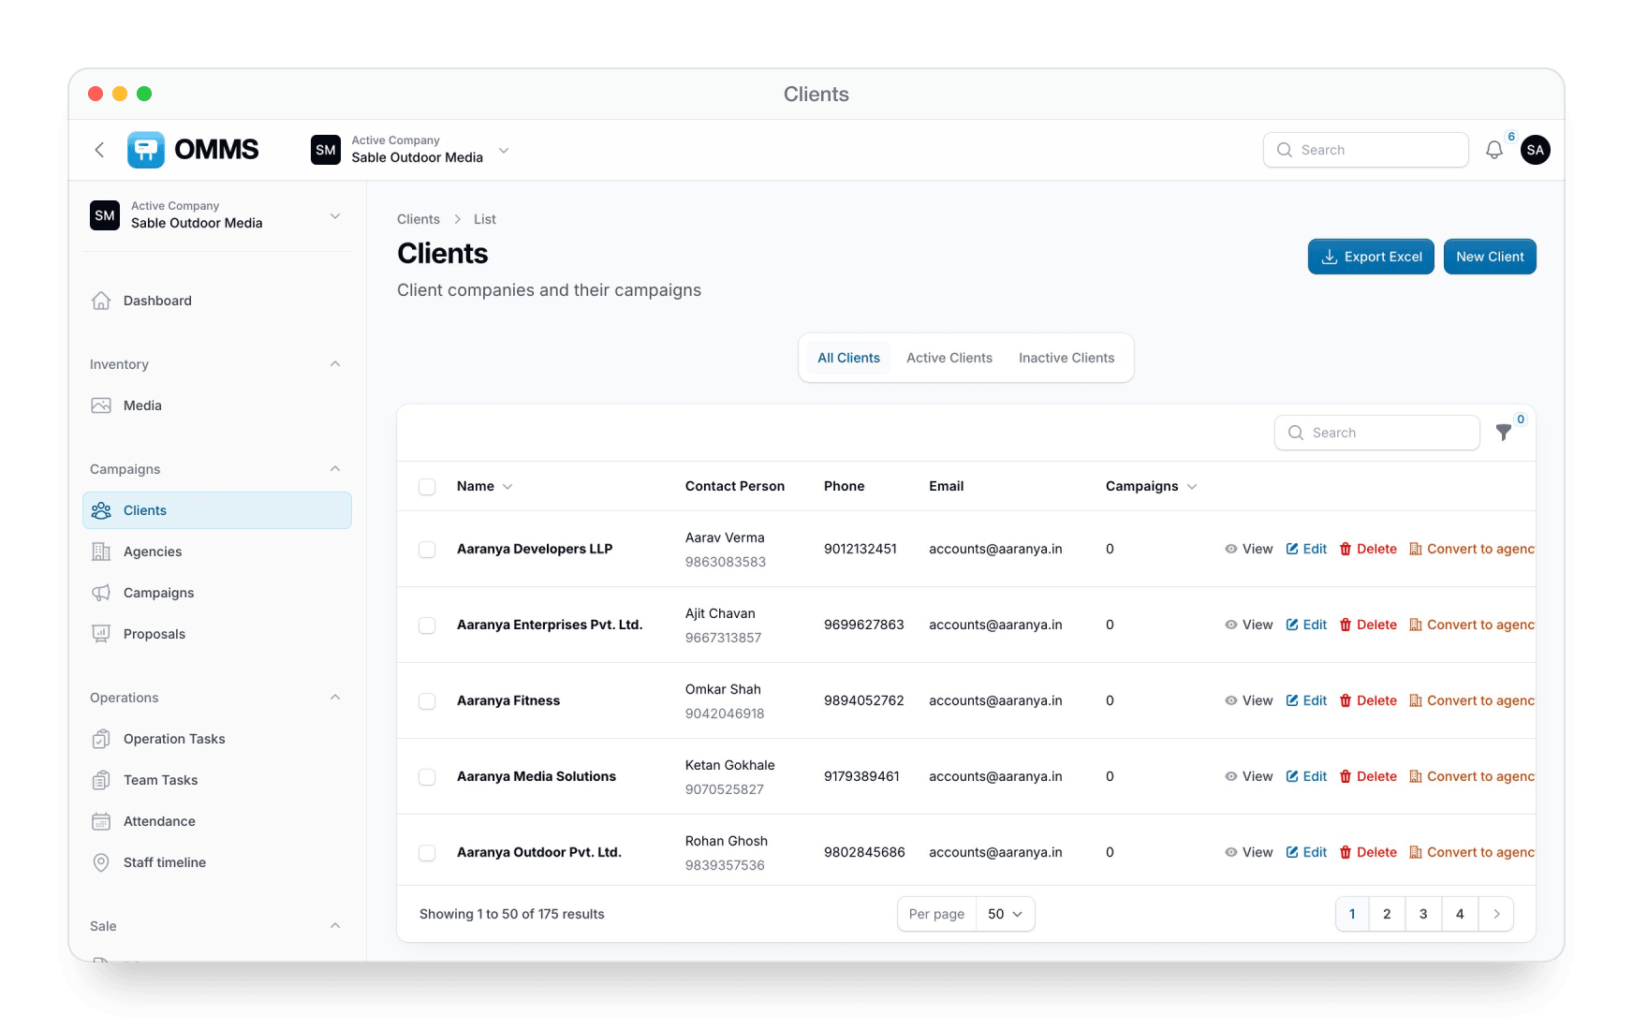
Clients and agencies
CLIENTS
Company details
GSTIN, PAN, credit period, bank accounts and addresses.
Contacts
Several contact people per client.
Keep the list clean
Merge duplicates and convert a client into an agency (or back).
Tabs and export
All, Active and Inactive, with Excel export.

Slide 12
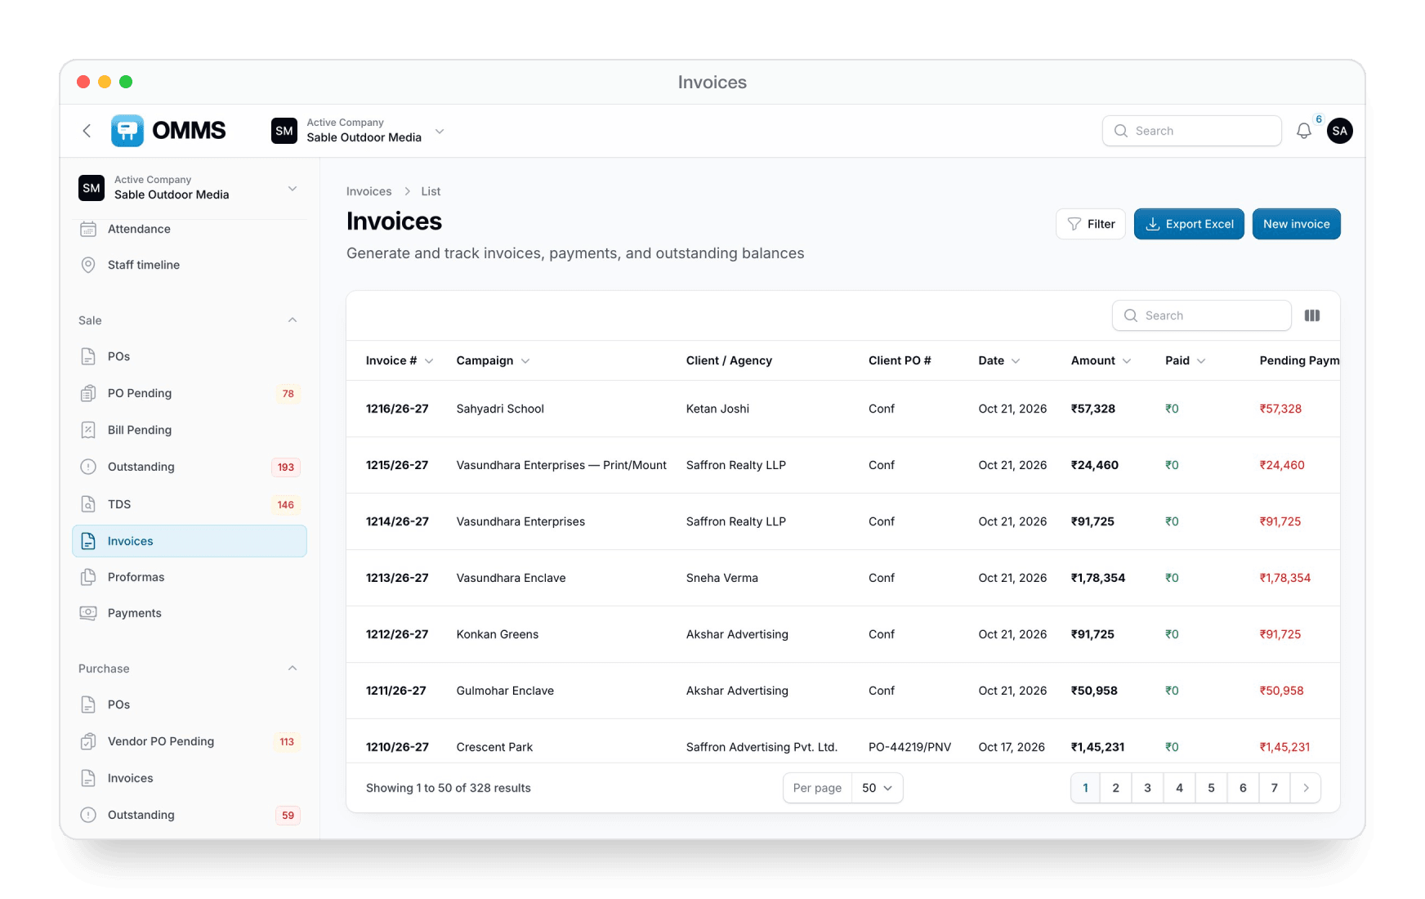
Client PO to GST invoice
SALE
POs
Record the client PO against a campaign and generate invoices in bulk.
Proformas
Raise a proforma before the tax invoice.
Invoices
Import lines from bookings, IGST or CGST/SGST, PDF download.
Payments
Record a payment straight from the invoice.

Slide 13
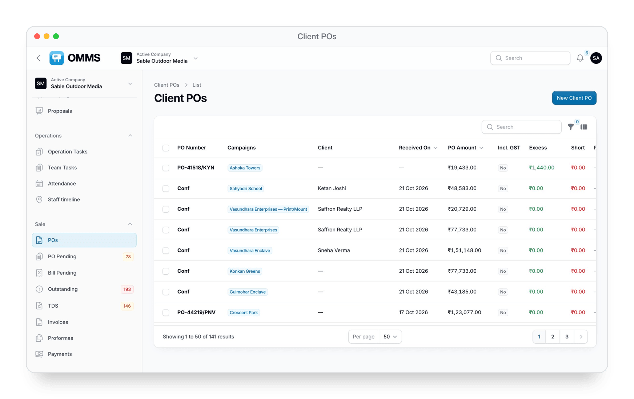
Client POs
Every client PO with amount, GST and how much of it has been invoiced.

Slide 14
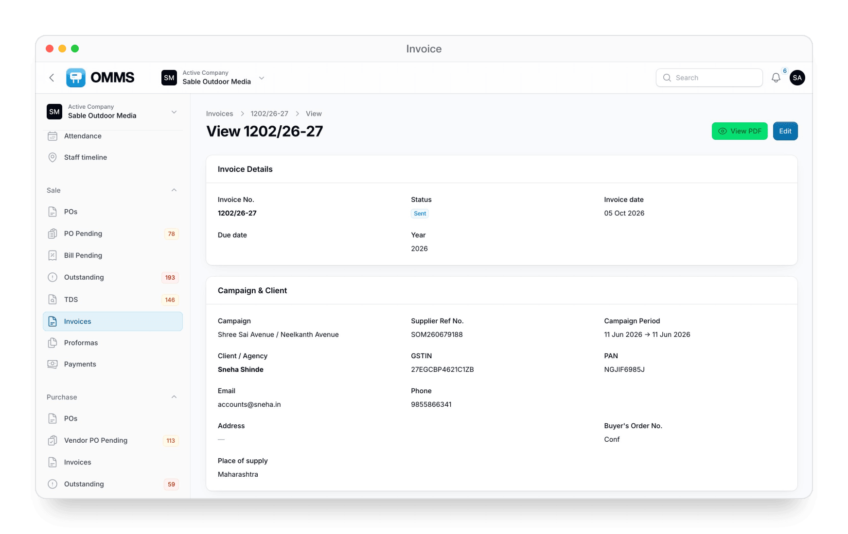
Invoice
Campaign, client, GSTIN, place of supply and line items — ready as a PDF.

Slide 15
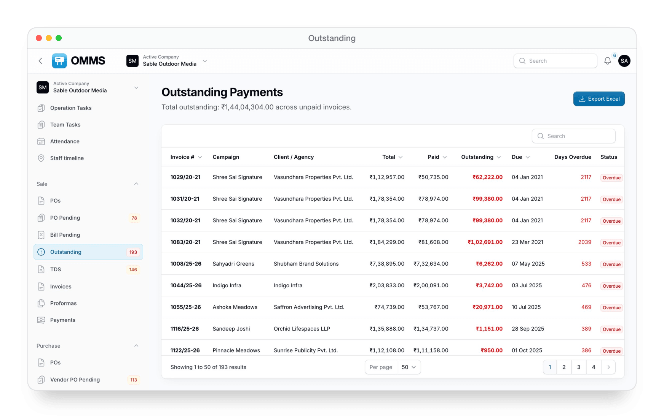
Know what is stuck, and where
COLLECTIONS
PO Pending
Campaigns still waiting for a client PO.
Bill Pending
PO received, invoice not raised yet.
Outstanding
Unpaid invoices with days overdue.
TDS
Deducted TDS to collect, marked collected or pending.
Counts in the sidebar
Each queue shows how many items are waiting.

Slide 16
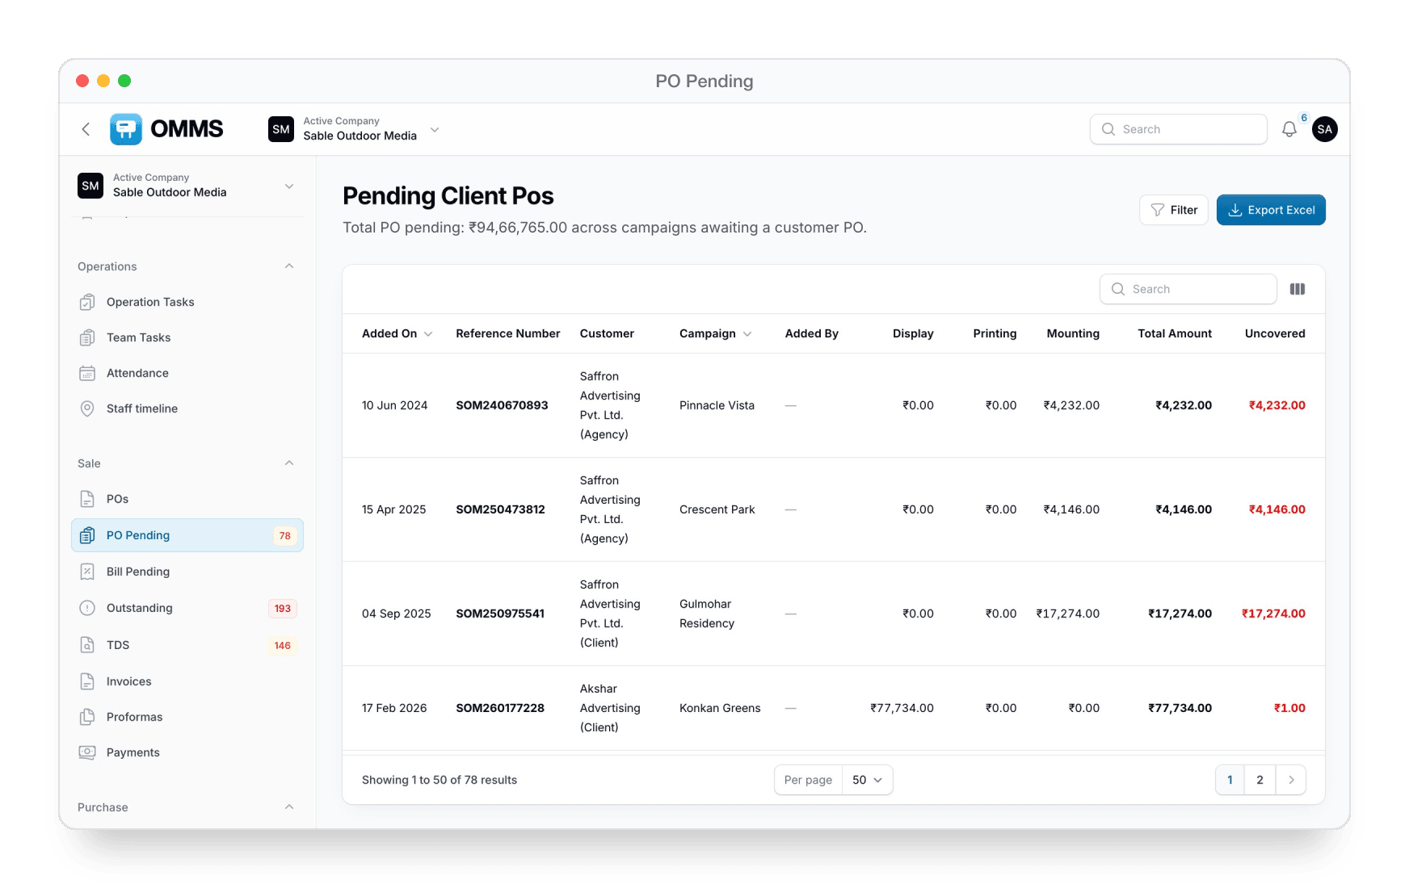
PO Pending
Display, printing and mounting value still uncovered by a customer PO.

Slide 17
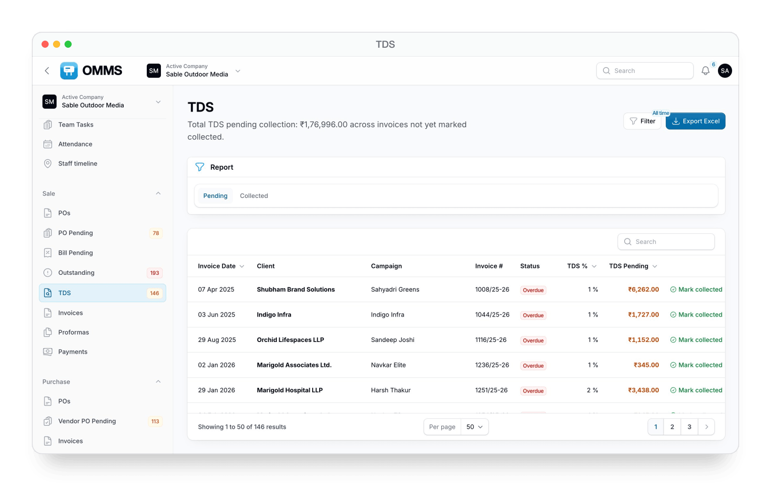
TDS
TDS pending collection by invoice, with one-click Mark collected.

Slide 18
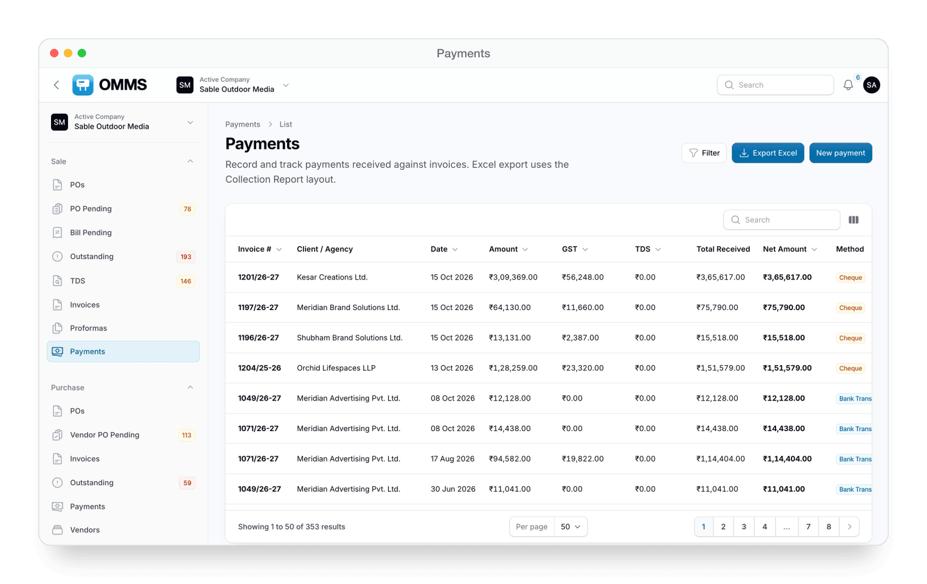
Payments
Every receipt with GST, TDS, net amount and payment method — PDF and Excel.

Slide 19
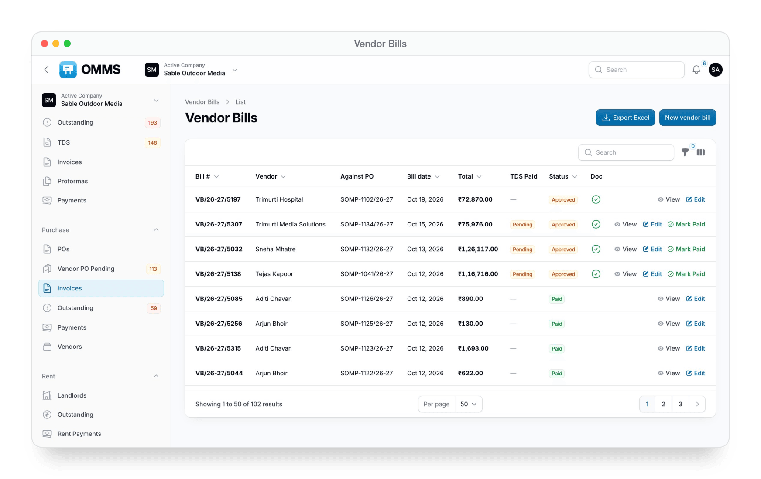
Printers, mounters and vendors
PURCHASE
Vendor PO Pending
Sites that still need a printing, mounting or removal PO.
Vendor POs
Create single or merged POs, email them, download PDF.
Vendor bills
Bill against a PO, approve, then pay.
Vendors
Directory by vendor type, with POs, bills, payments and tasks.

Slide 20
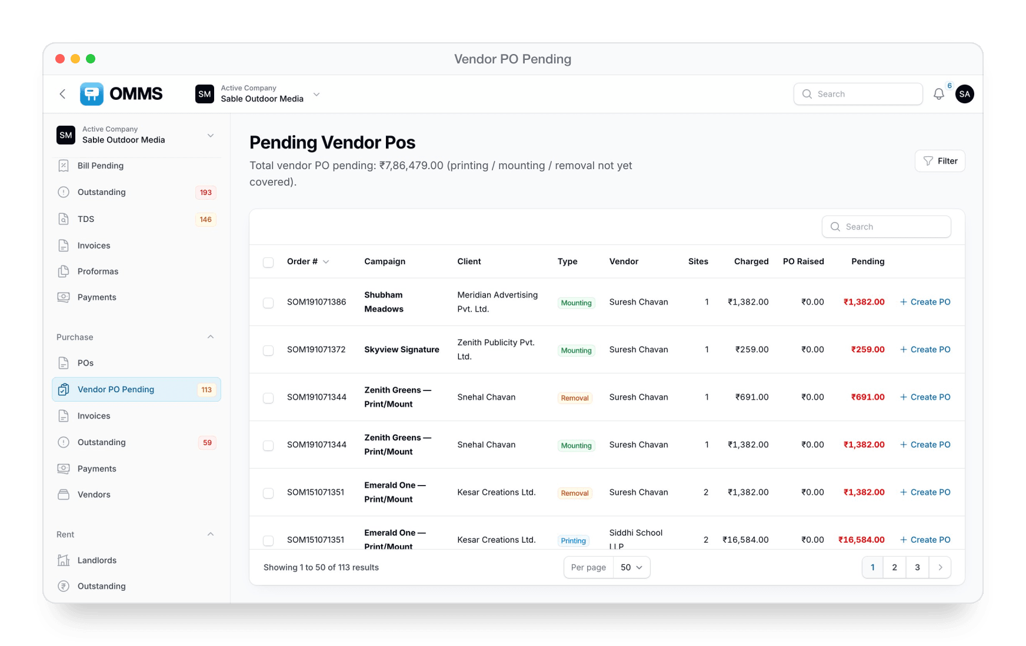
Vendor PO Pending
What has been charged to the client but not yet ordered from a vendor.

Slide 21
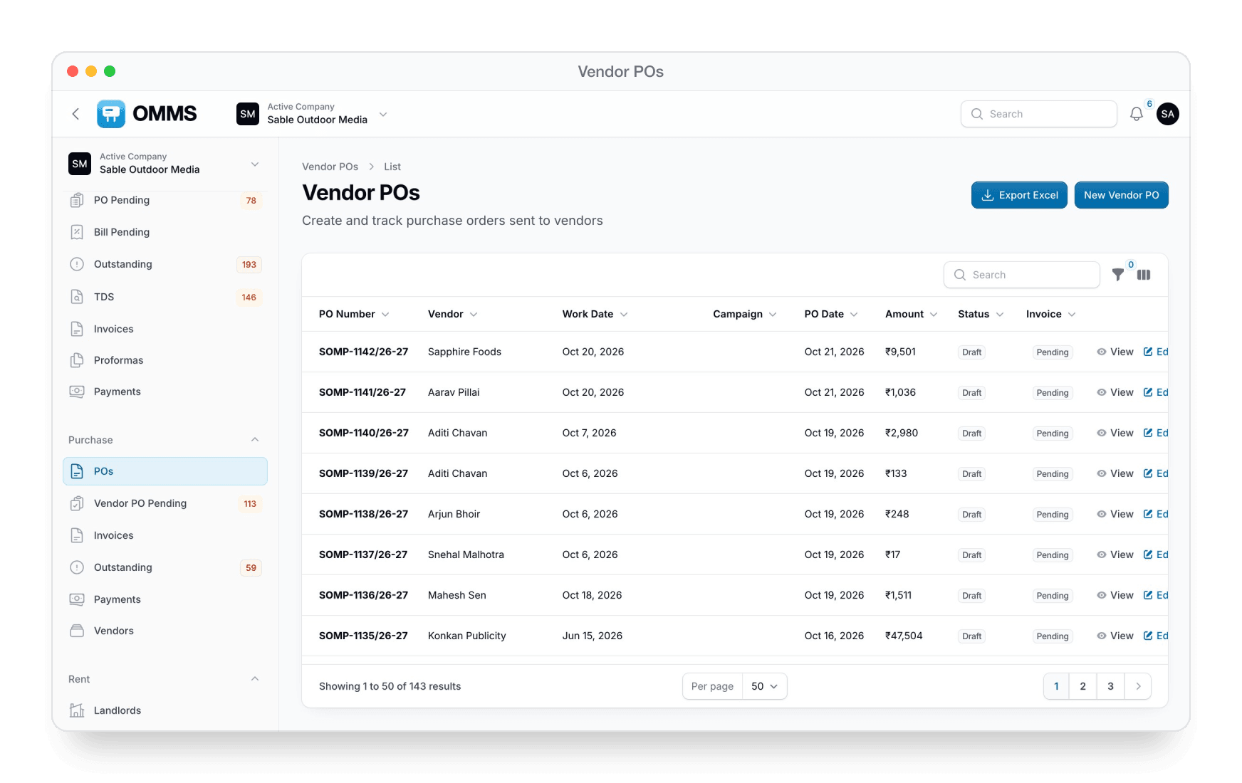
Vendor POs
Work date, campaign, amount and status for every PO sent to a vendor.

Slide 22
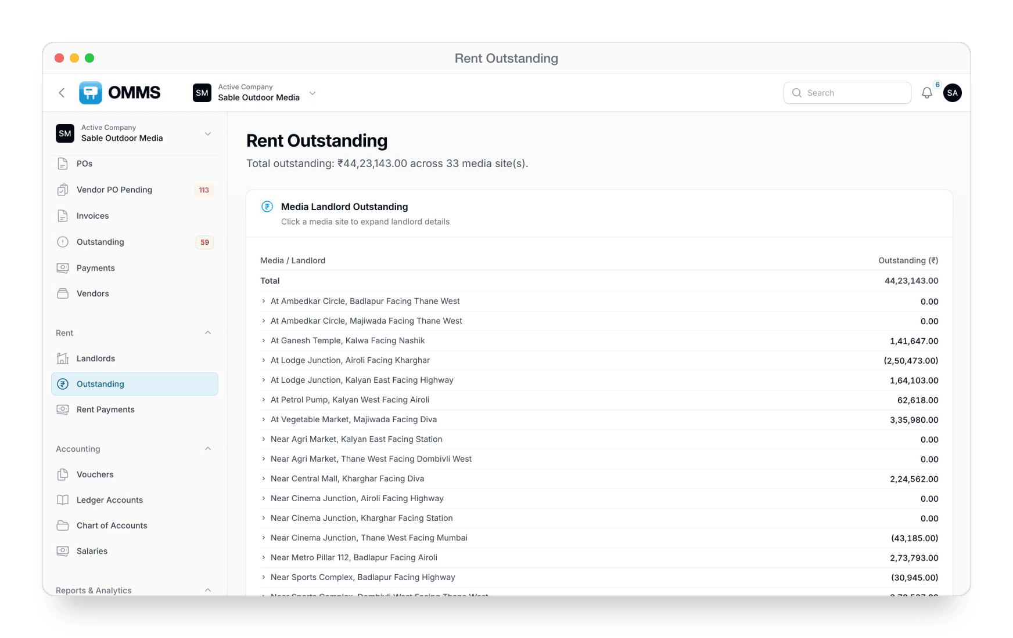
Landlords and site rent
RENT
Landlords
Owners you pay rent to, with their sites and bank details.
Outstanding
Rent due by site and landlord.
Rent Payments
Pay a landlord and keep the history.
Renewal alerts
Reminders before a rent period ends.

Slide 23
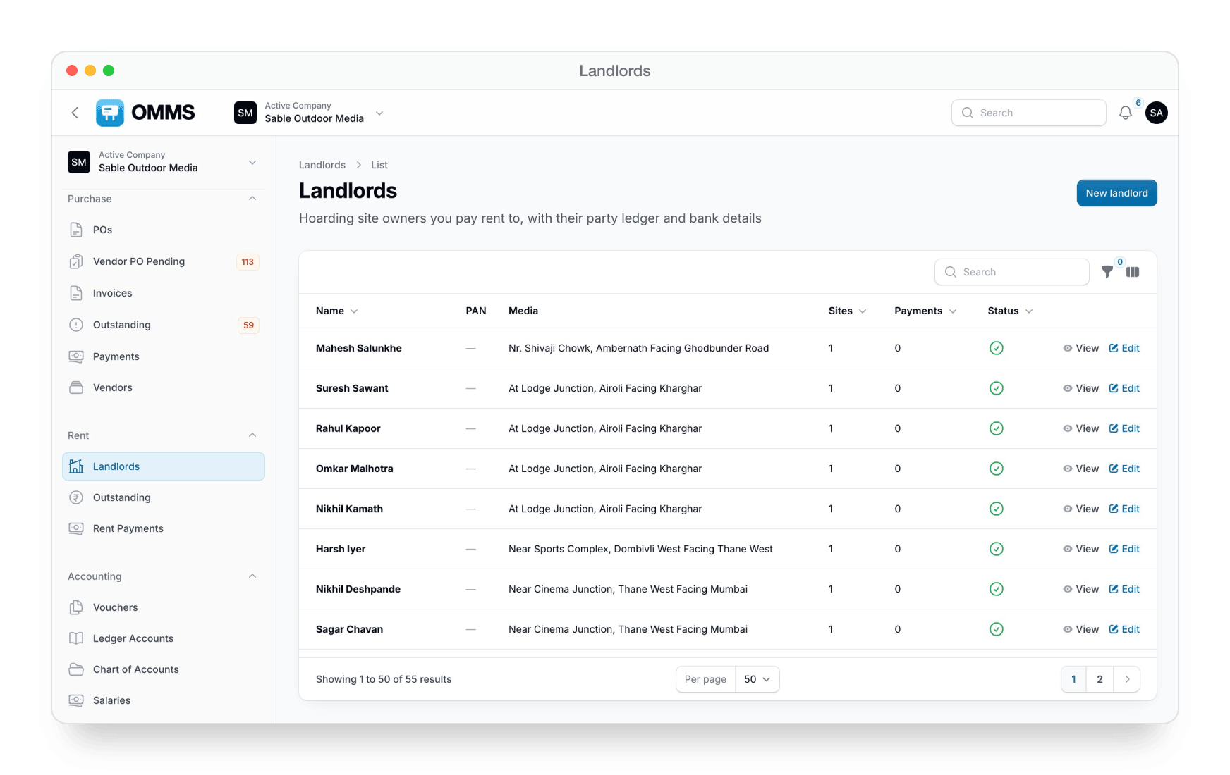
Landlords
Each landlord with their sites, payments and status.

Slide 24
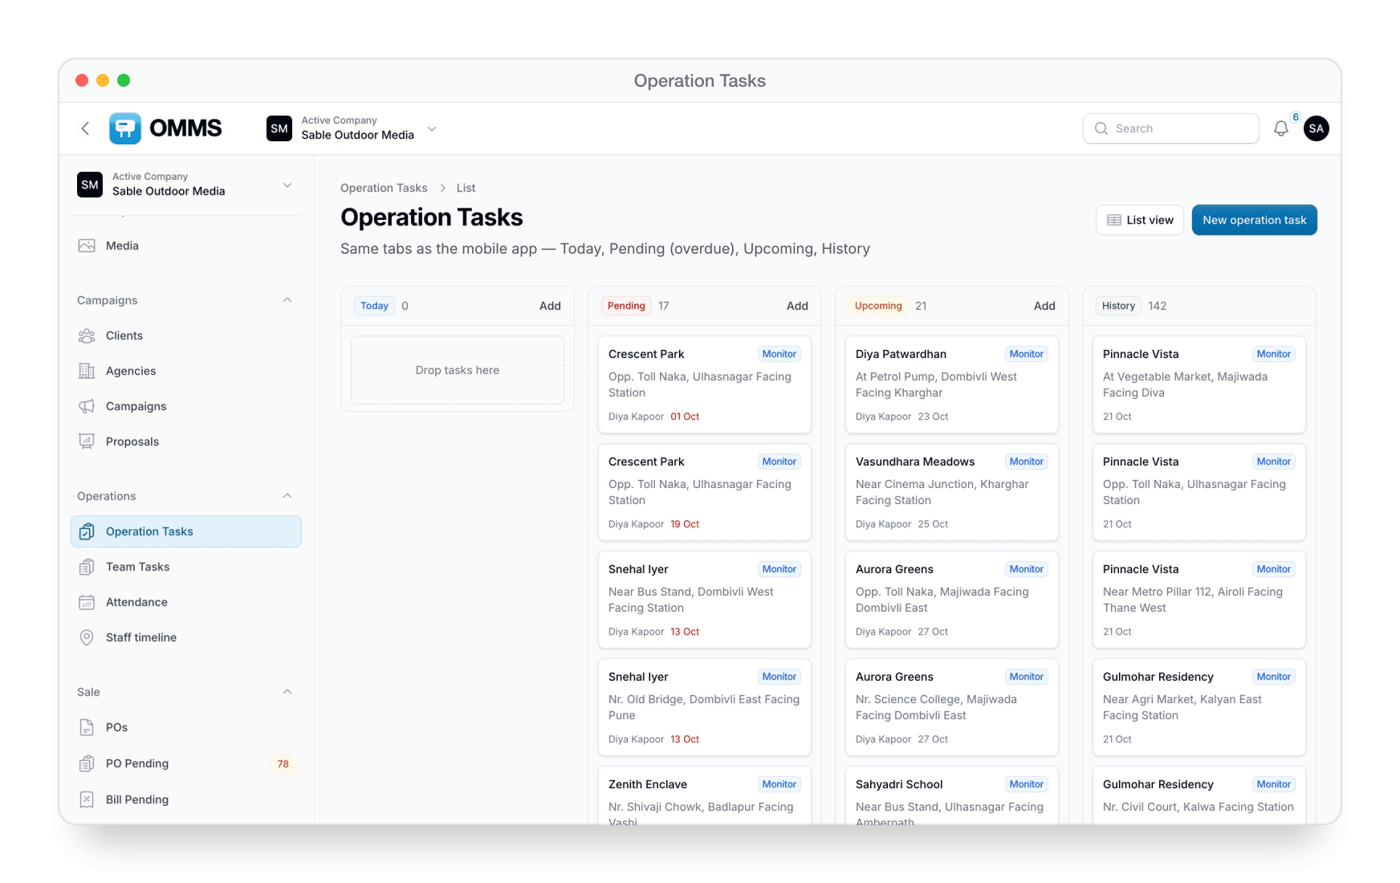
Mounting and monitoring tasks
OPERATIONS
Board or list
Today, Pending, Upcoming and History.
Per-site tasks
Printing, mounting and monitoring, assigned to staff or a vendor.
Automatic monitor visits
Created daily from the campaign schedule.
Proof from the field
Photos and videos uploaded from the mobile app.

Slide 25
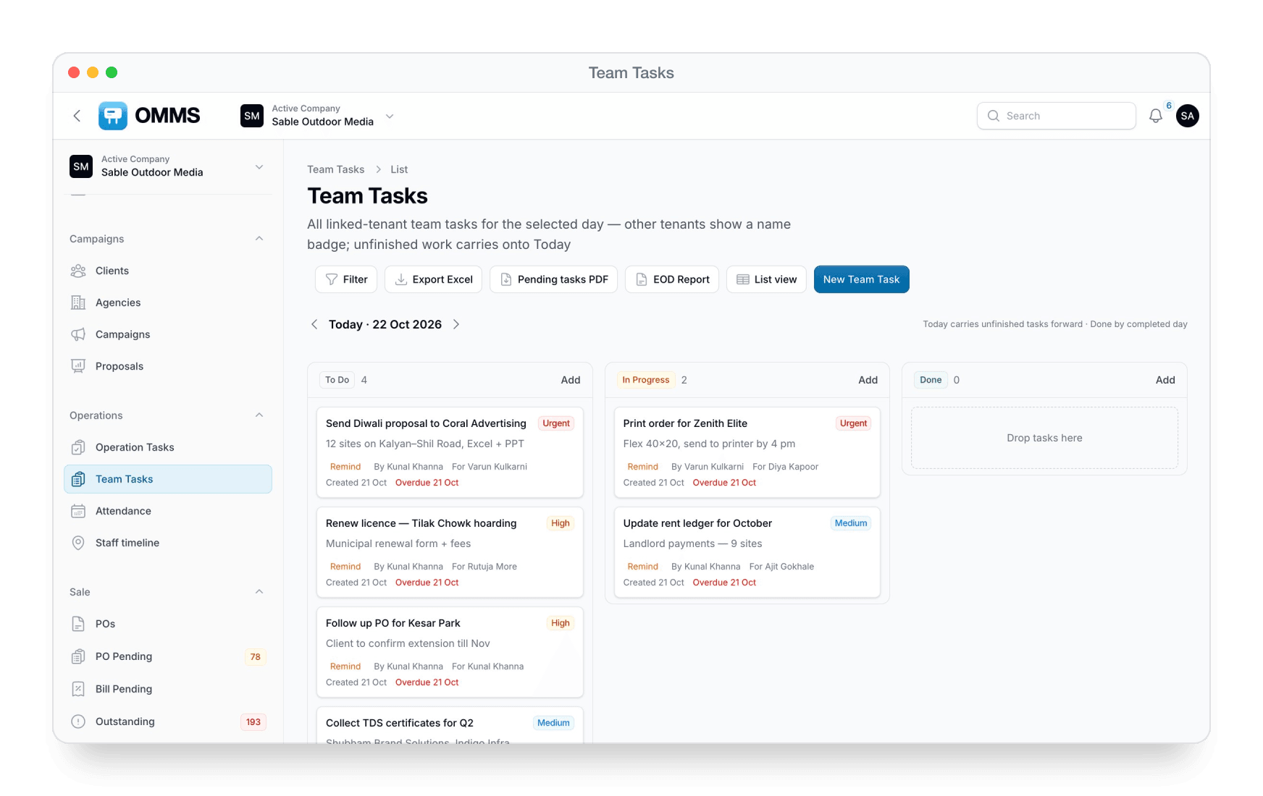
The office to-do board
TEAM TASKS
To do, In progress, Done
With priority, due date and assignee.
End-of-day report
Copy, share or download as PDF, plus a pending-tasks PDF.
Reminders
Remind people about pending work; delays need a reason.
From the phone
Staff create and close team tasks in the app.

Slide 26
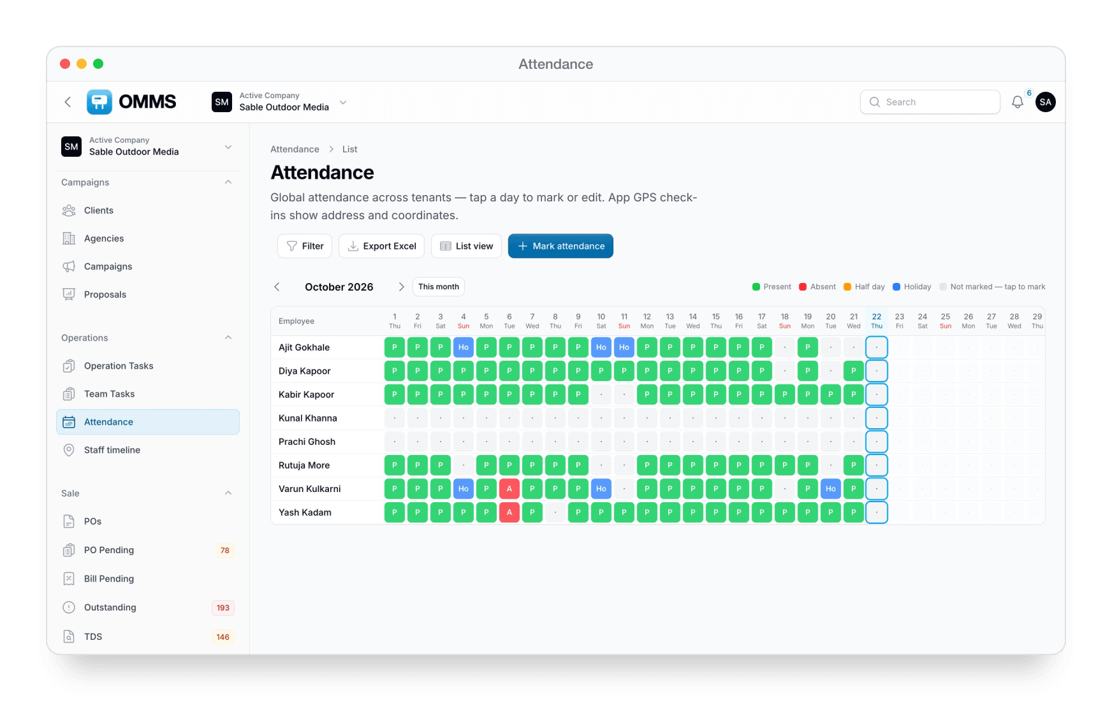
Attendance and salaries
PEOPLE
Monthly roster
Present, absent, half day and holiday for everyone.
GPS check-in
Staff check in from the app; the address is saved.
Salaries
Monthly package, payments, payslips and salary ledgers.
KYC
Bank details and identity documents per staff member.

Slide 27
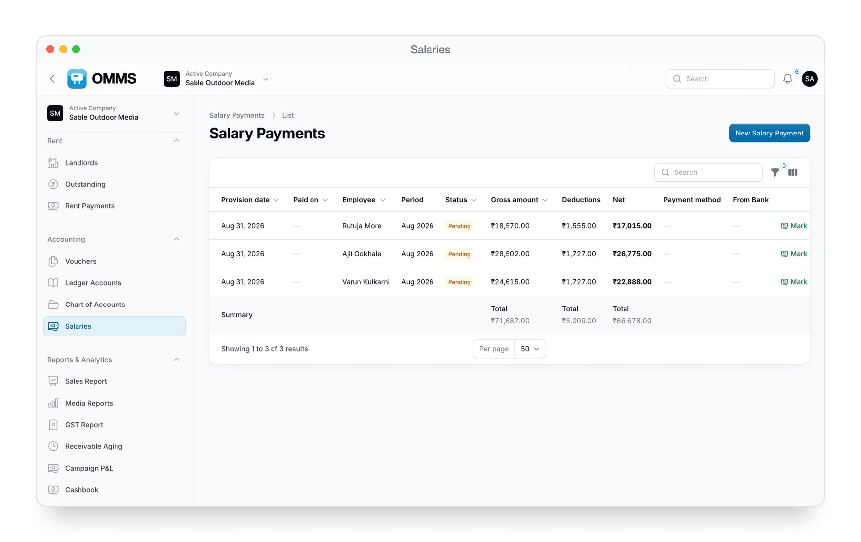
Salaries
Gross, deductions and net pay per person each month — mark paid and download PDF.

Slide 28
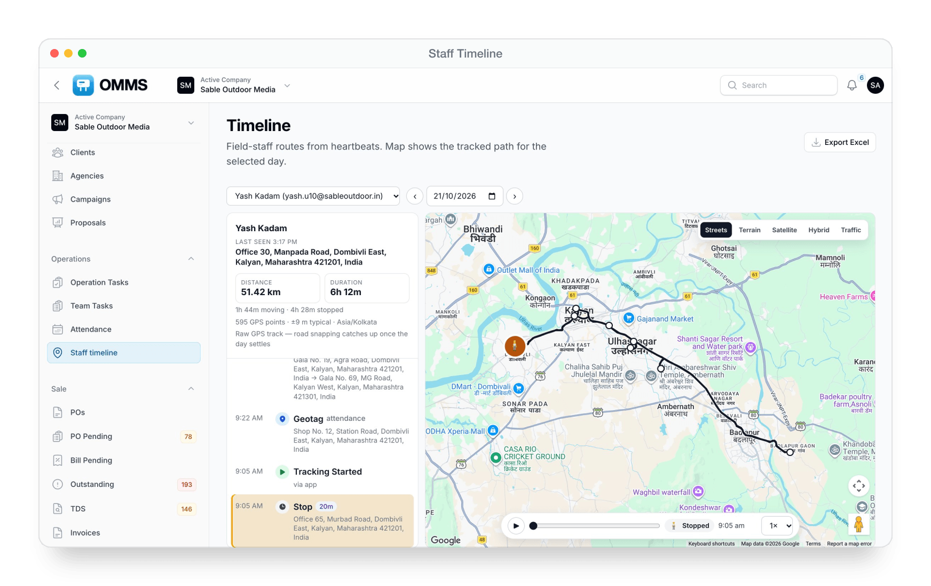
Staff timeline
Each field staff member's GPS route for the day: distance, drives, stops and addresses, with playback.

Slide 29
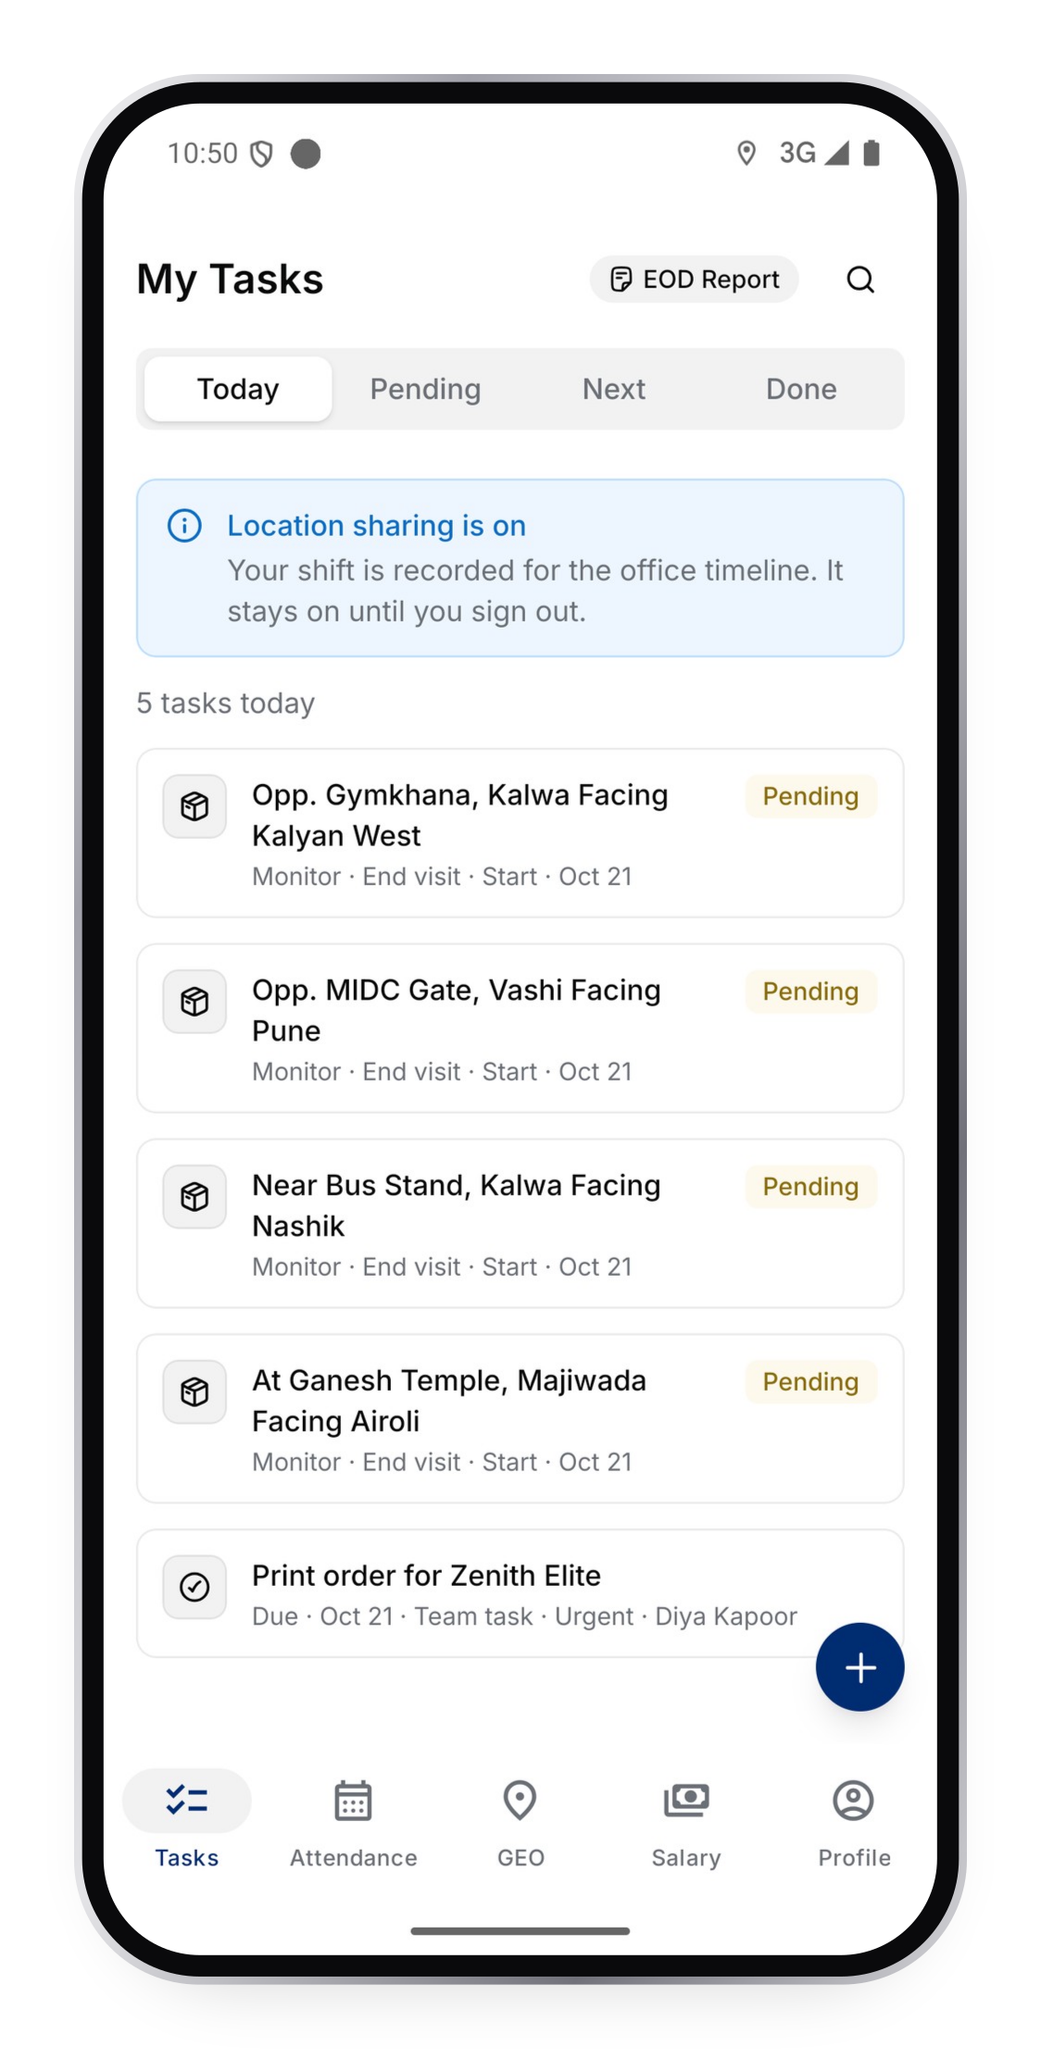
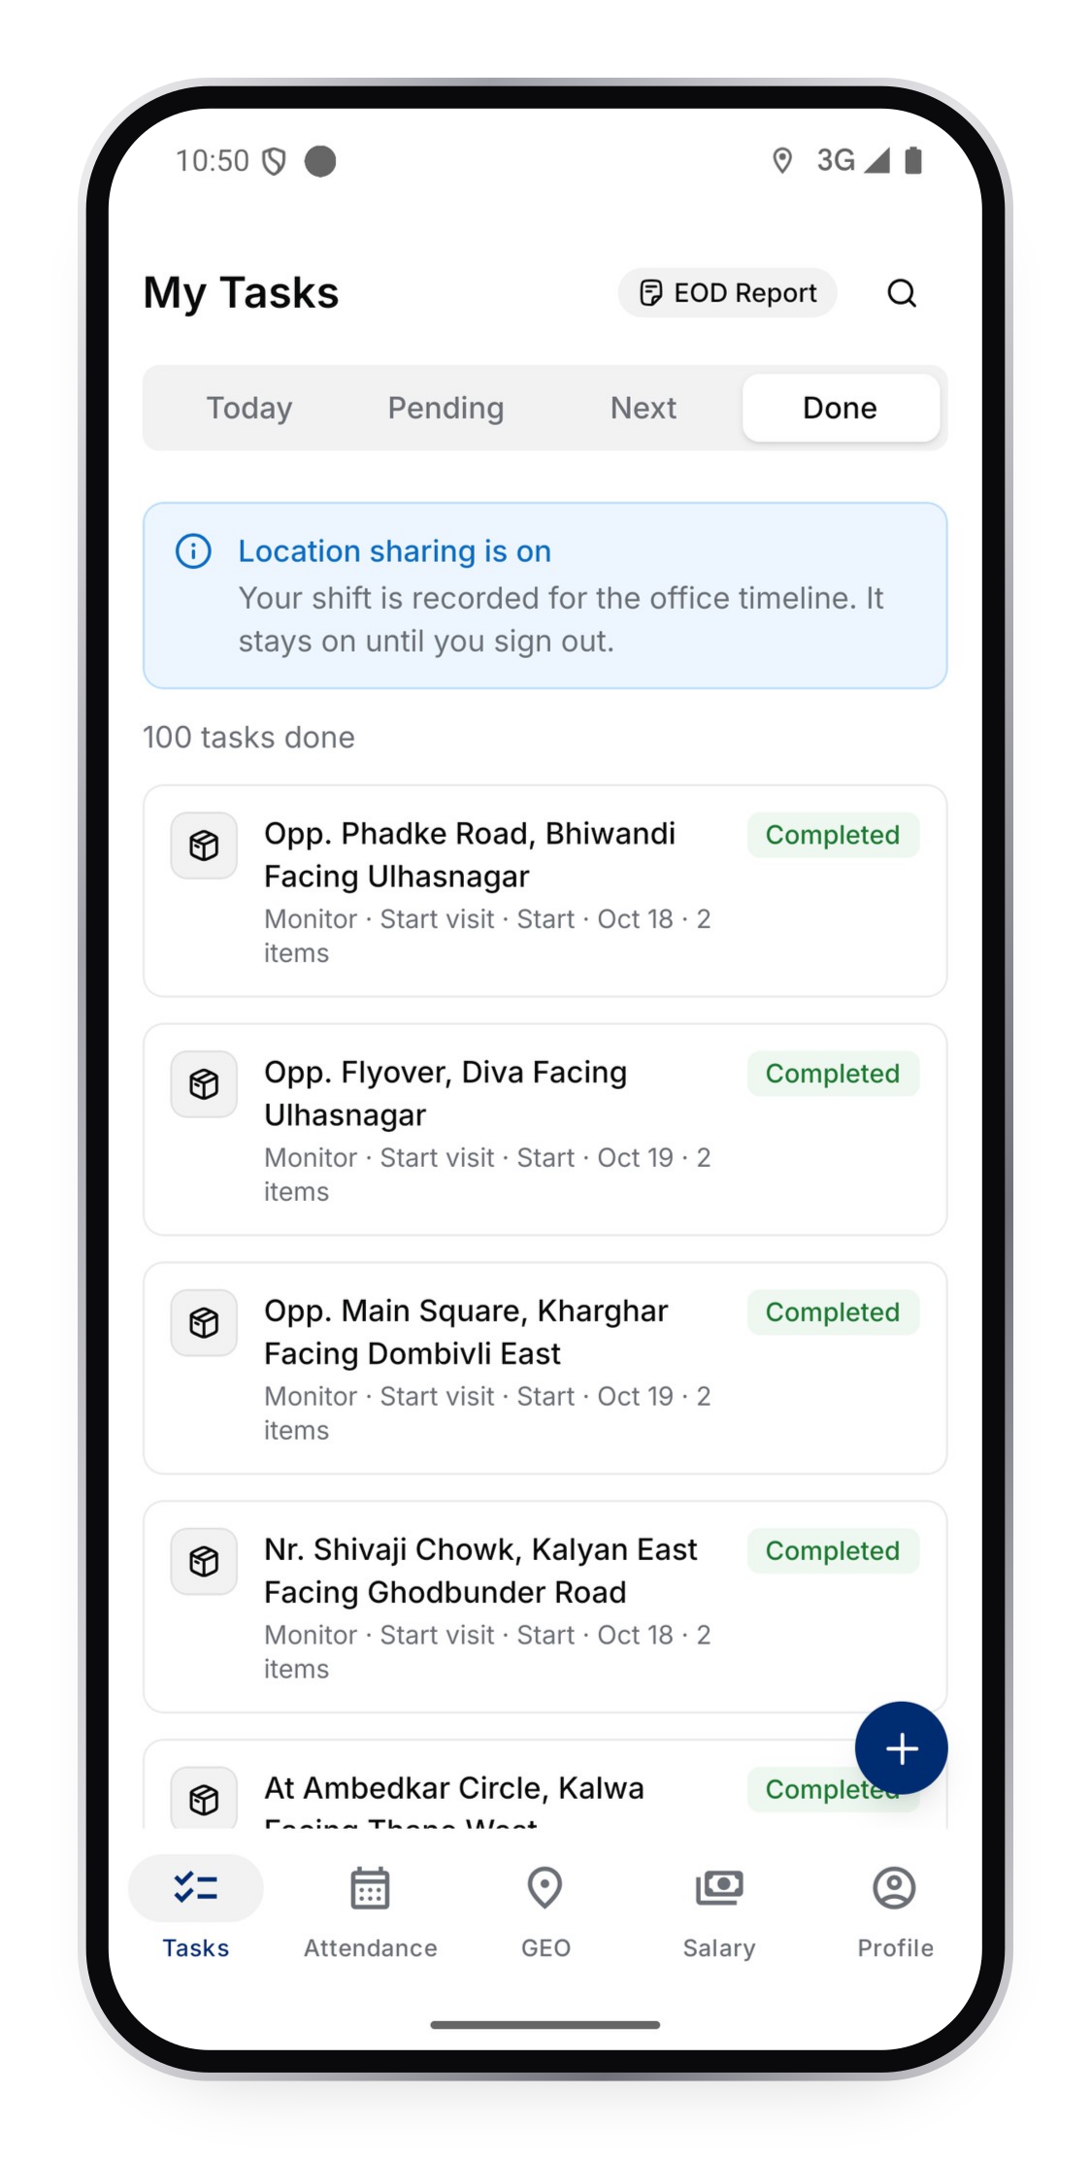
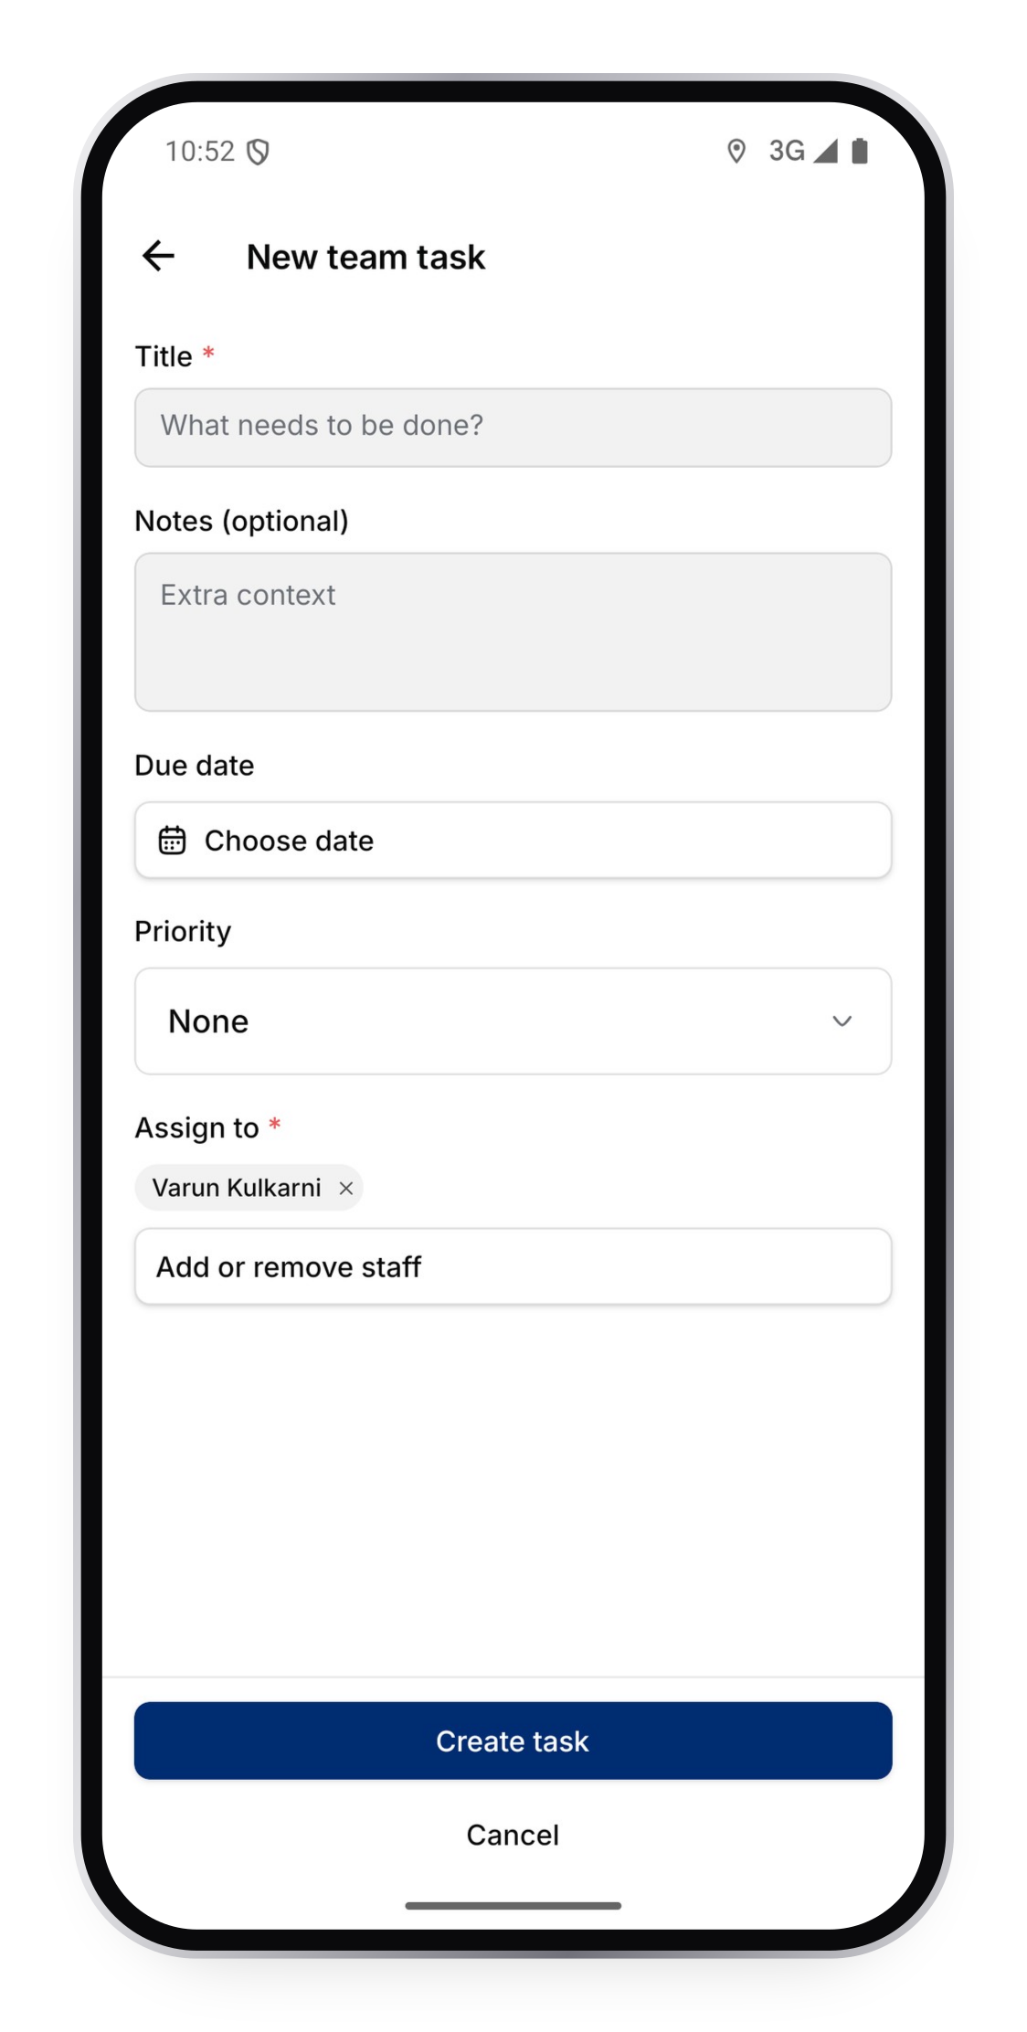

Today's work in their pocket
FIELD APP
Today, Pending, Next, Done
Every site visit and team task assigned to them.
Proof on site
Upload photos and videos; GPS is needed to complete.
Create team tasks
Assign work to colleagues from the phone.
Tasks
Done
New team task

Slide 30
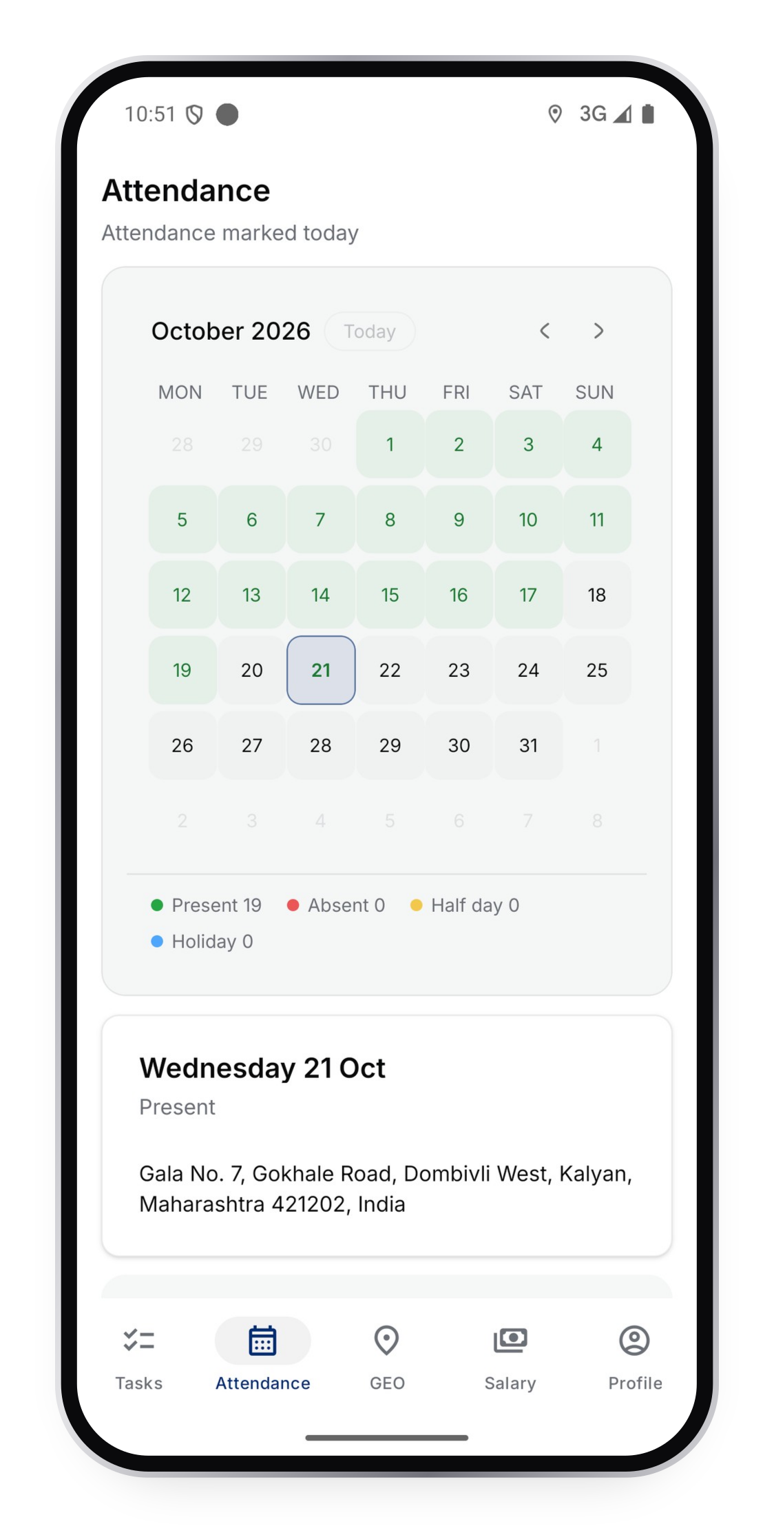
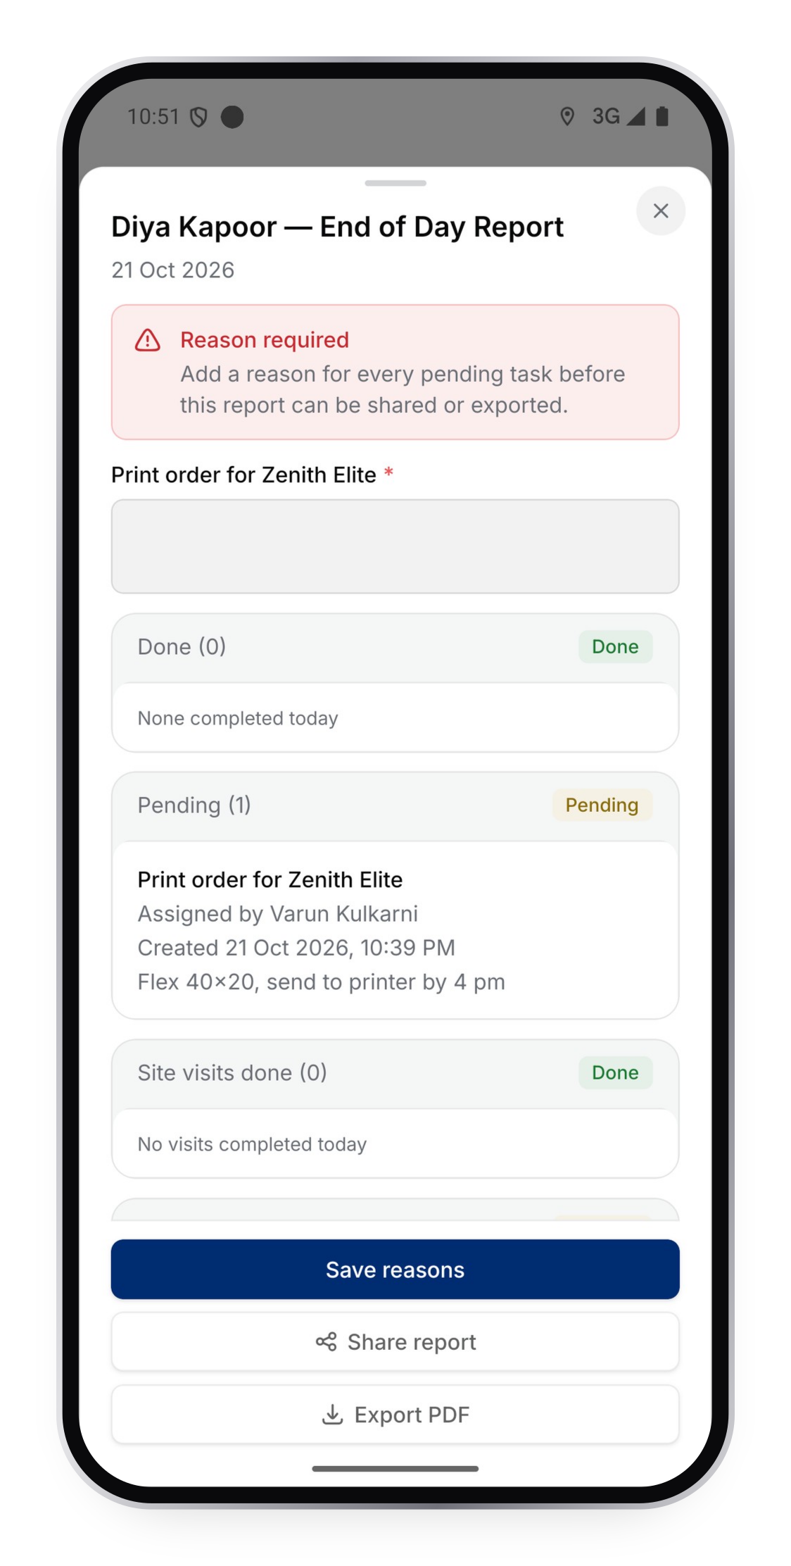
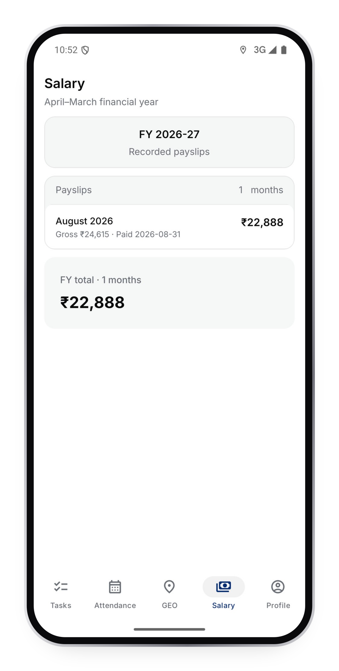
Attendance, salary and EOD report
FIELD APP
Check in with GPS
Present, half day, holiday or absent with a reason.
End-of-day report
Pending items need a reason before it is shared.
Payslips
Salary by financial year.
Attendance
EOD report
Salary

Slide 31
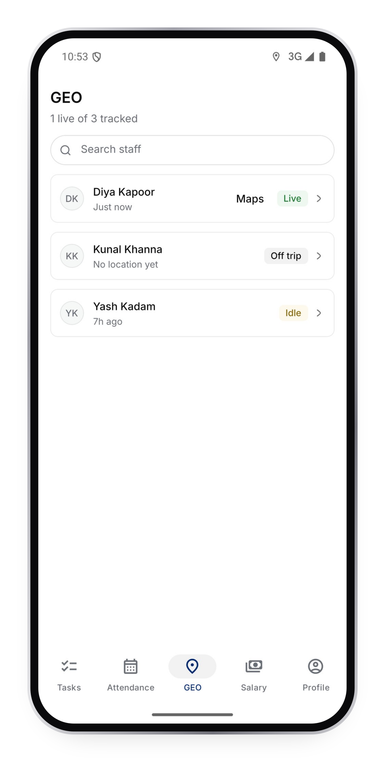
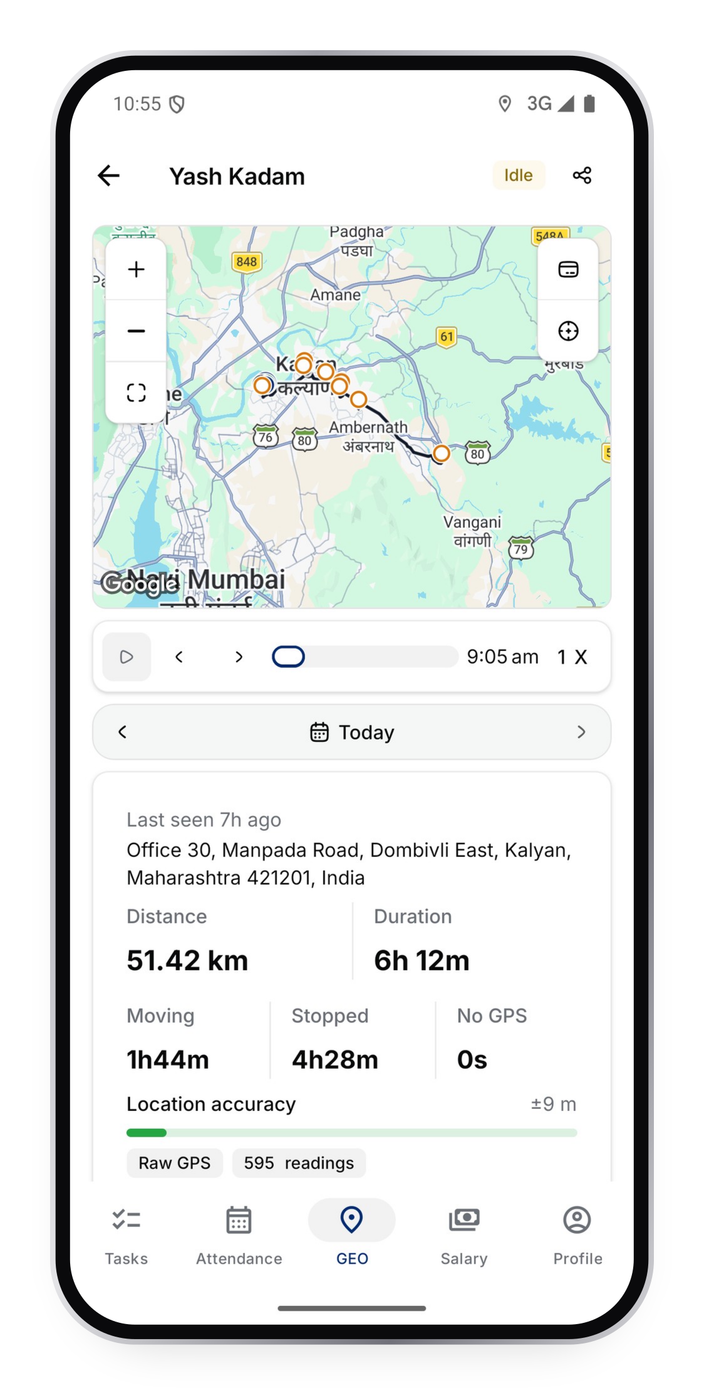
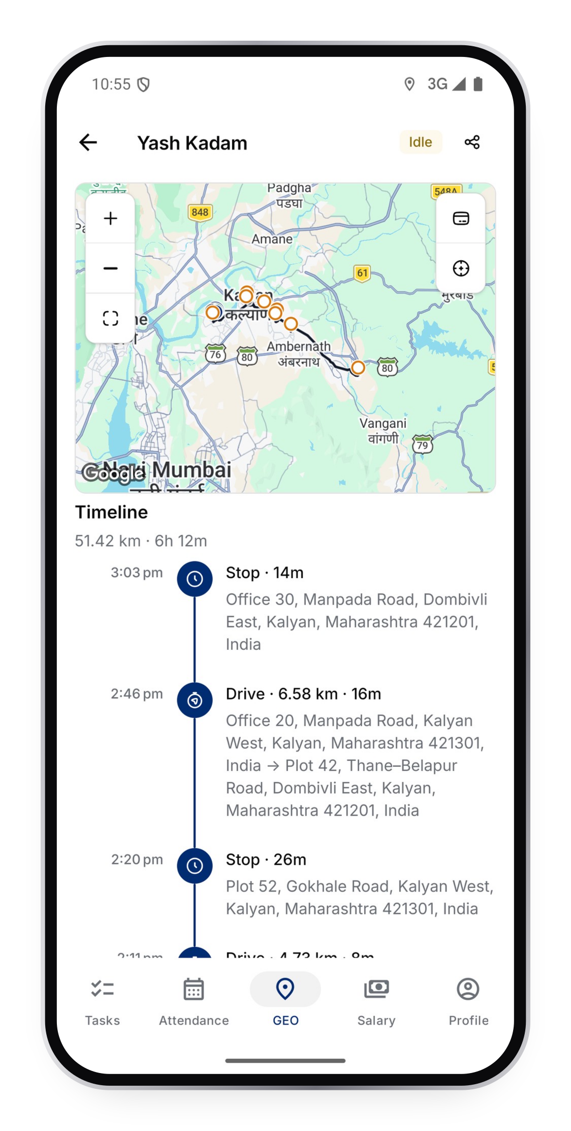
GEO: where the team is
FIELD APP
Live list
Who is live, idle or off trip.
Day route
Distance, duration, moving and stopped time on a map.
Trip timeline
Every drive, walk and stop with its address.
Staff list
Day route
Timeline

Slide 32
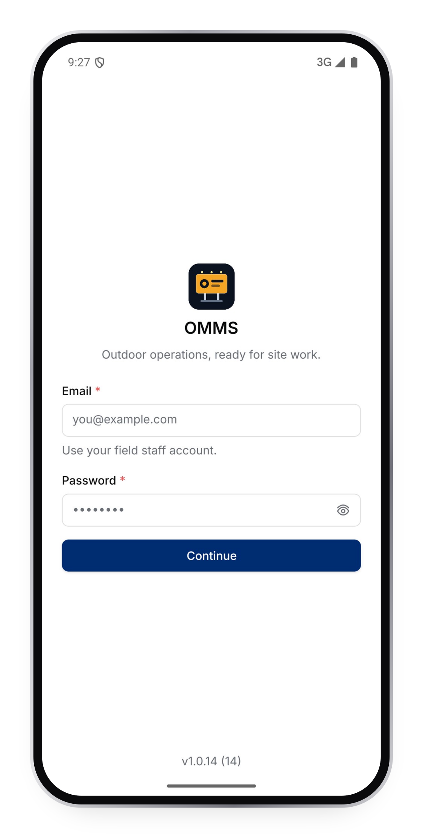
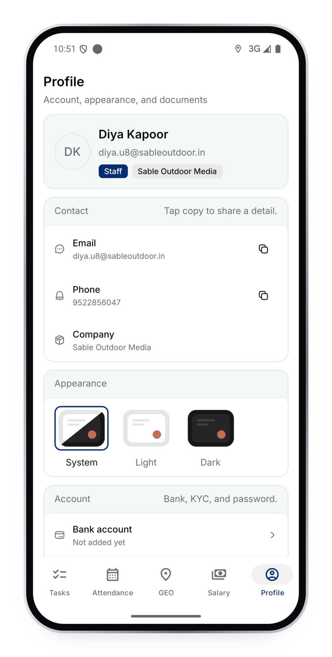
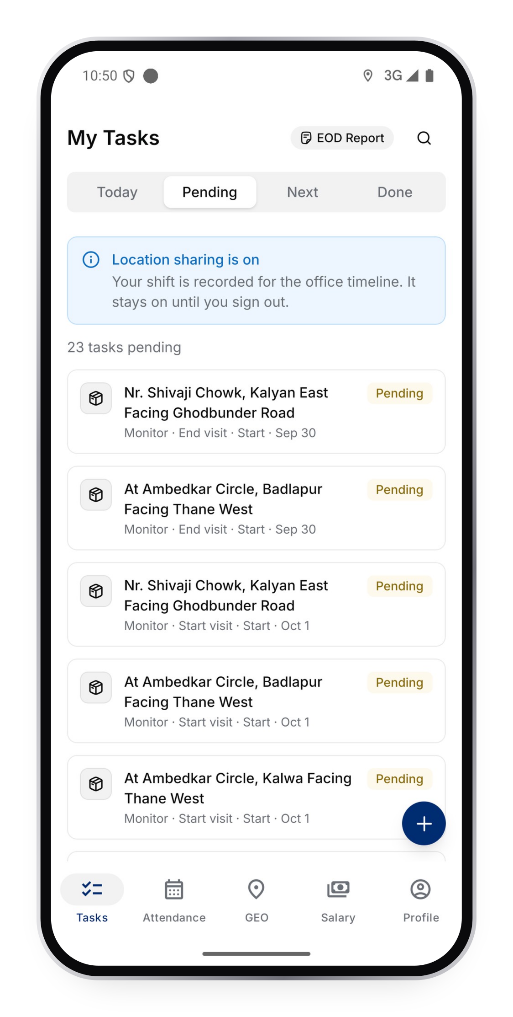
Simple sign-in, own profile
FIELD APP
Sign in
Email and password. Location sharing stays on until they sign out.
Profile
Contact details, company, bank account and KYC documents.
Appearance
System, light or dark.
Sign in
Profile
Pending

Slide 33
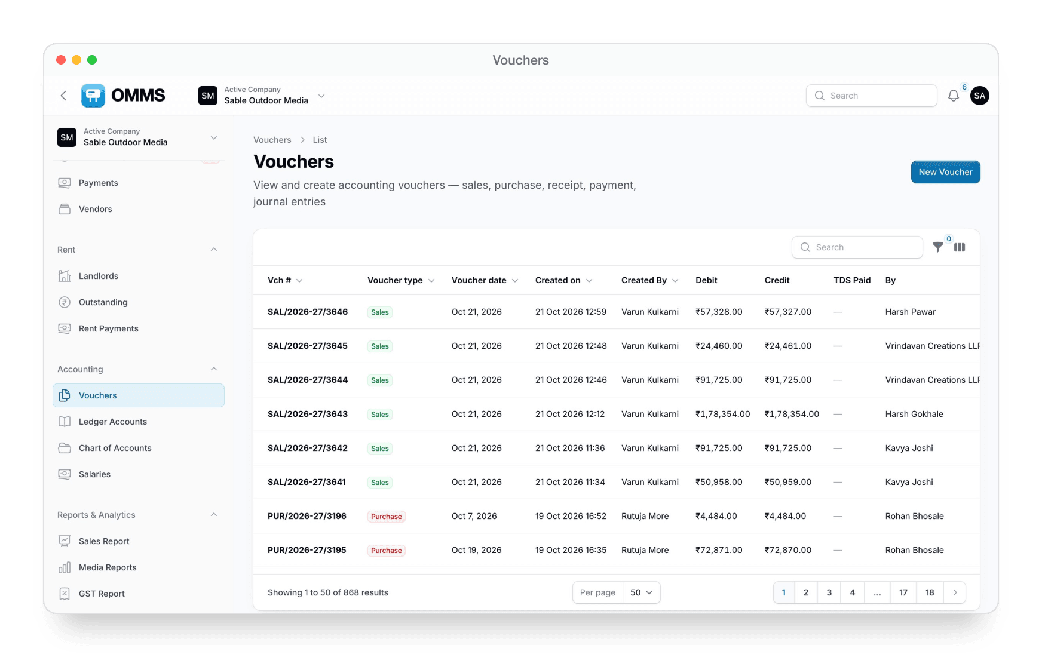
Books built for media billing
ACCOUNTING
Vouchers
Sales, purchase, payment, receipt, journal, credit and debit notes.
Ledgers
Ledger accounts and a chart of accounts for clients, vendors and sites.
Books
Cashbook, Bank Book, Day Book and Ledger Statement (PDF).
Year end
Bank reconciliation and year closing.

Slide 34
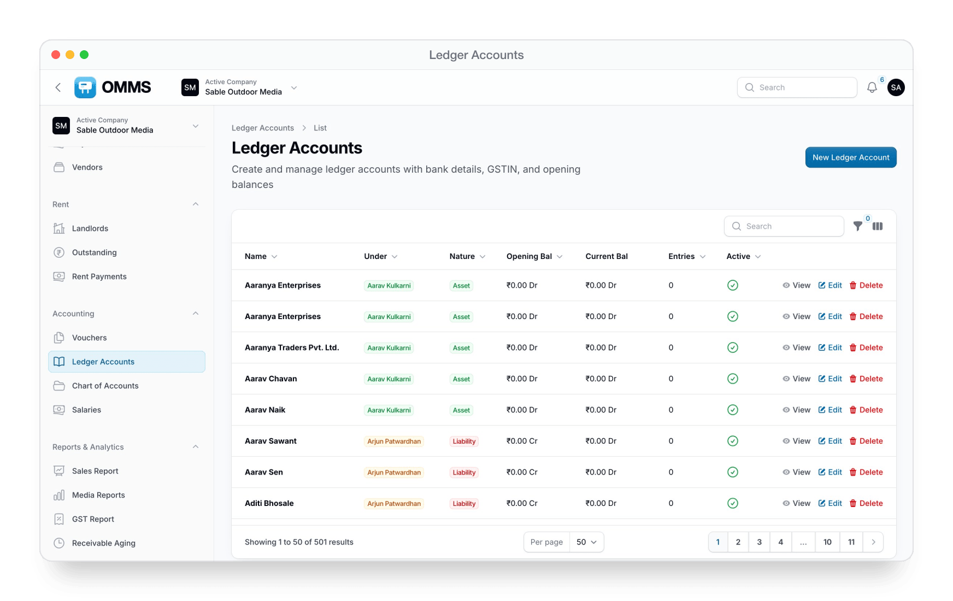
Ledger Accounts
Every client, vendor and site ledger with group, opening and current balance.

Slide 35
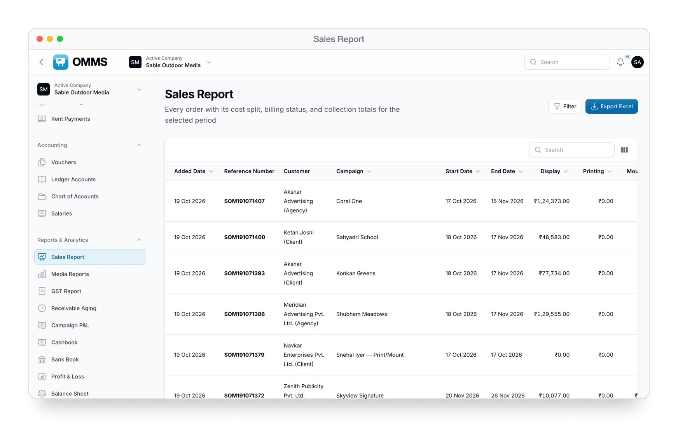
Reports owners and finance ask for
REPORTS
Sales Report
Every order with its cost split, billing and collection status.
GST Report and GSTR-1
Taxable value, CGST, SGST, IGST and outward supplies.
Media Reports
Revenue, cost and profit for every site.
Campaign P&L and aging
Profit per campaign and receivables by overdue bucket.
Financial statements
Profit & Loss, Balance Sheet and Trial Balance.

Slide 36
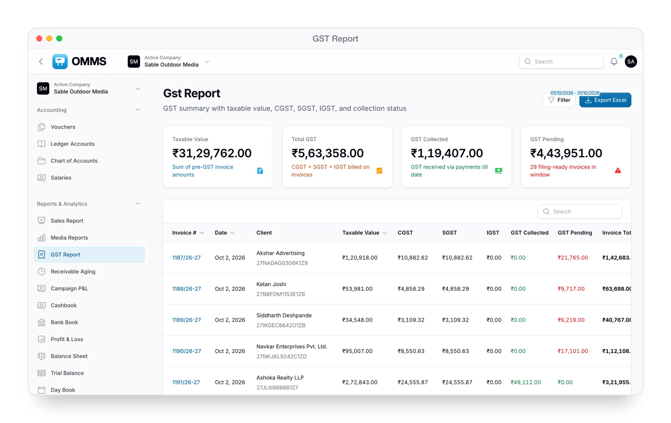
GST Report
Taxable value and GST collected or pending, invoice by invoice.

Slide 37
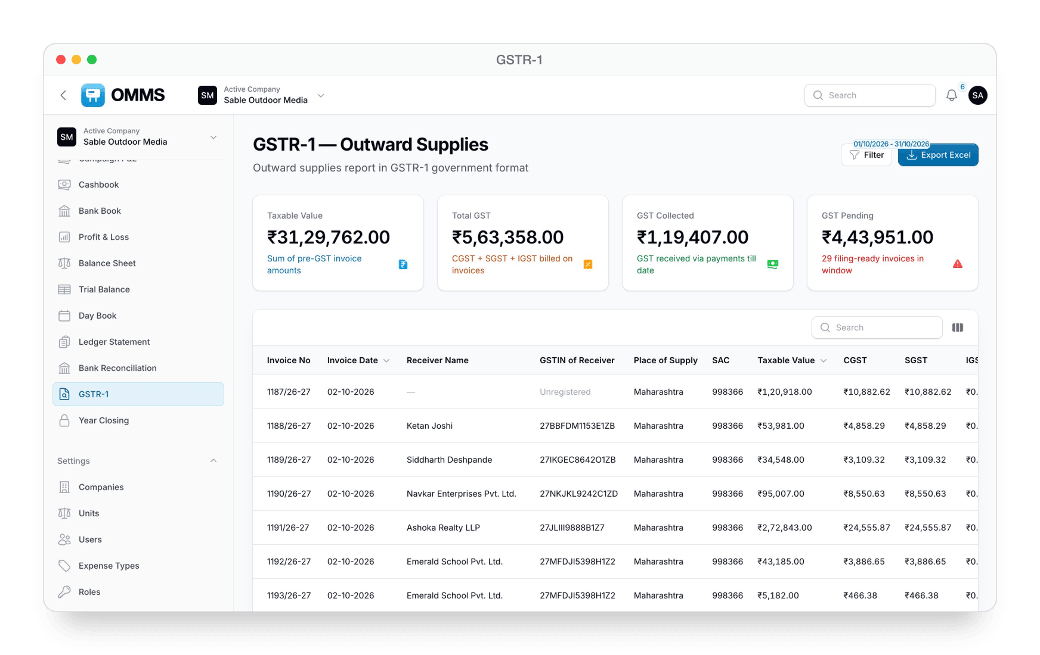
GSTR-1
Outward supplies in the GSTR-1 format, ready to file.

Slide 38
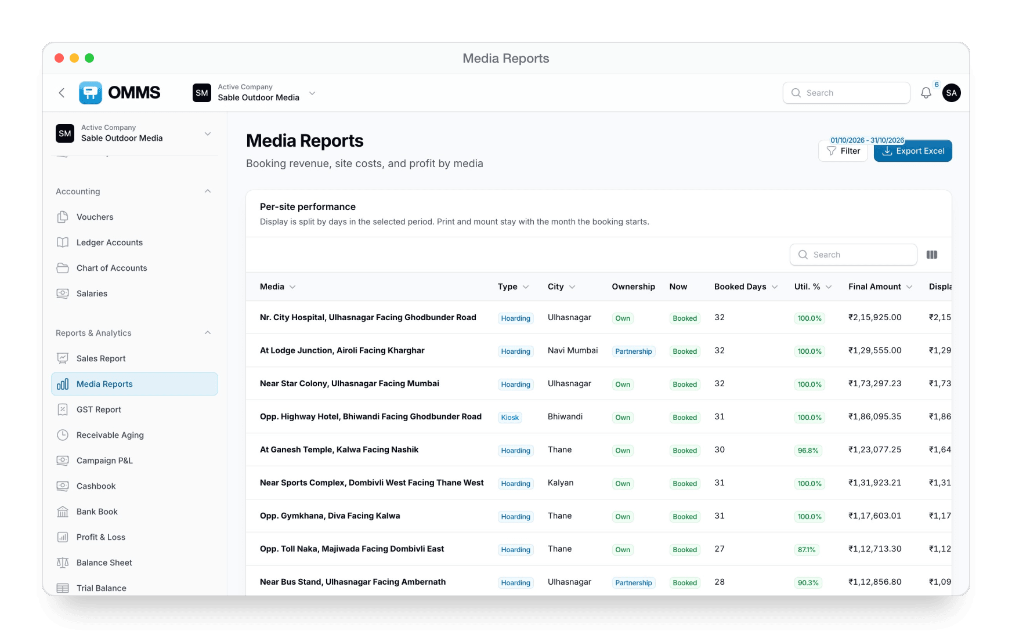
Media Reports
Days booked, utilisation and revenue for each site.

Slide 39
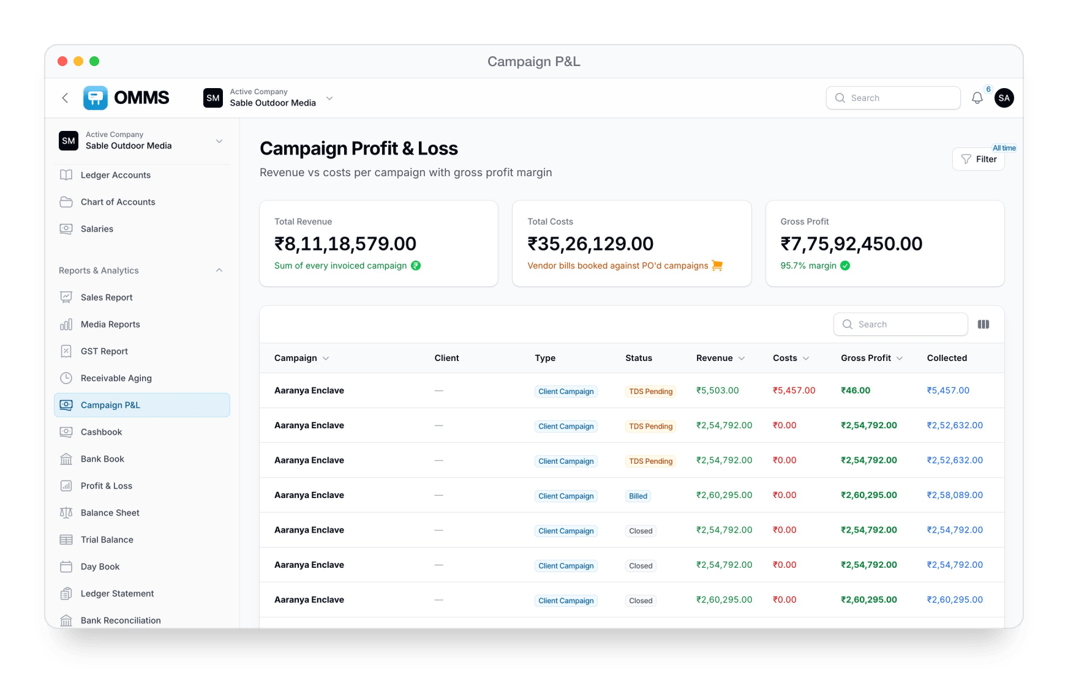
Campaign P&L
Revenue against vendor costs for each campaign, with gross margin.

Slide 40
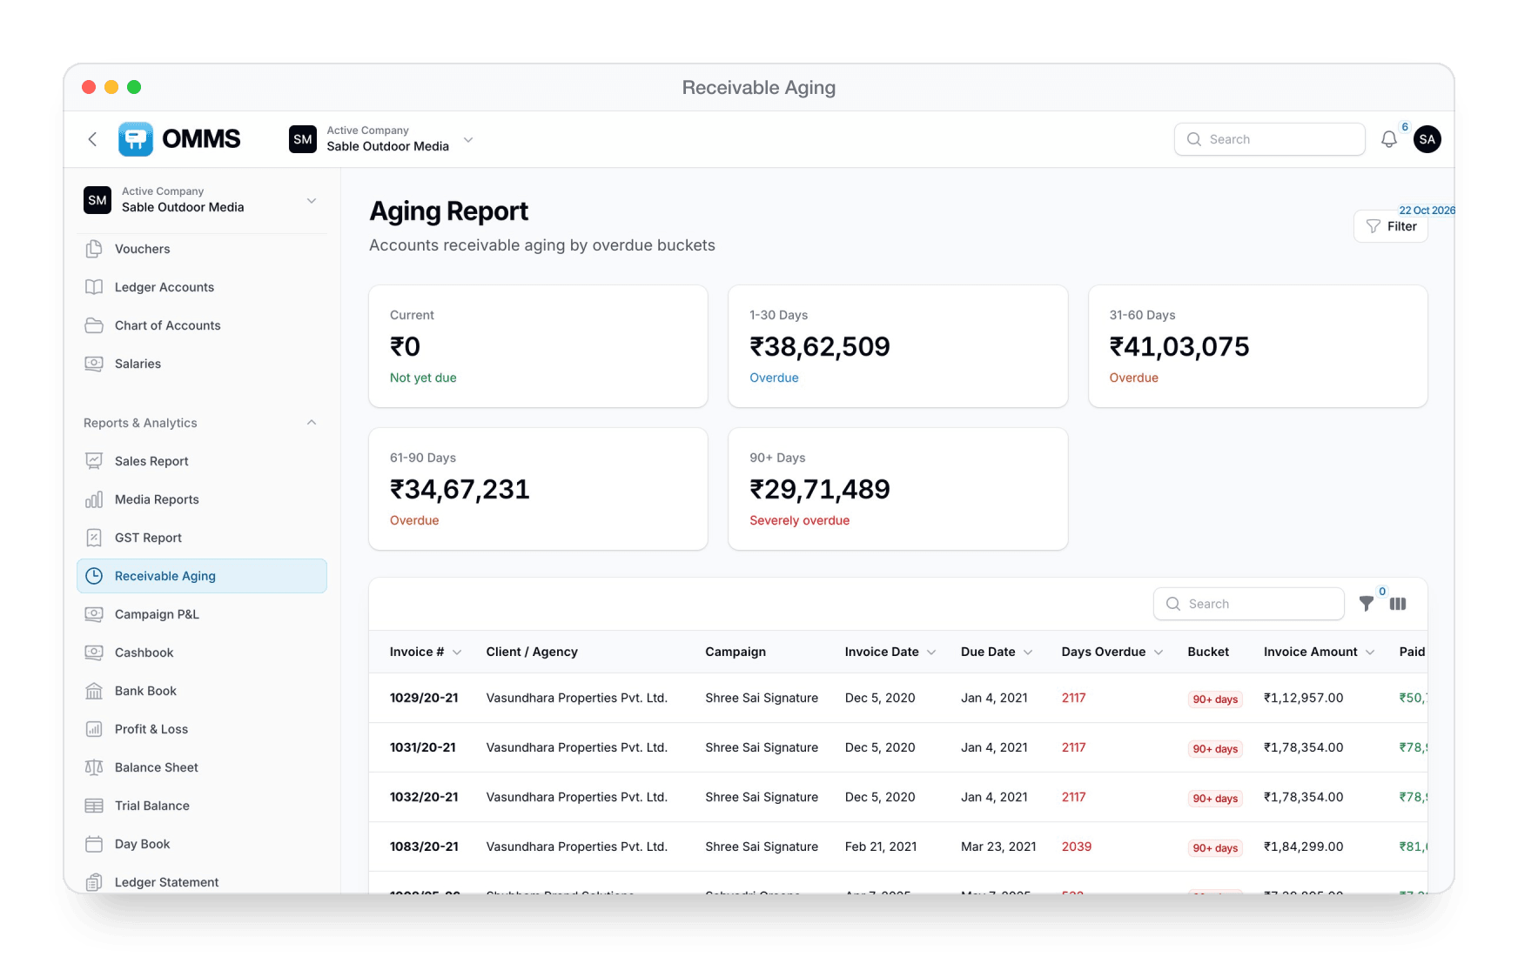
Receivable Aging
Outstanding invoices grouped into 1–30, 31–60, 61–90 and 90+ days.

Slide 41
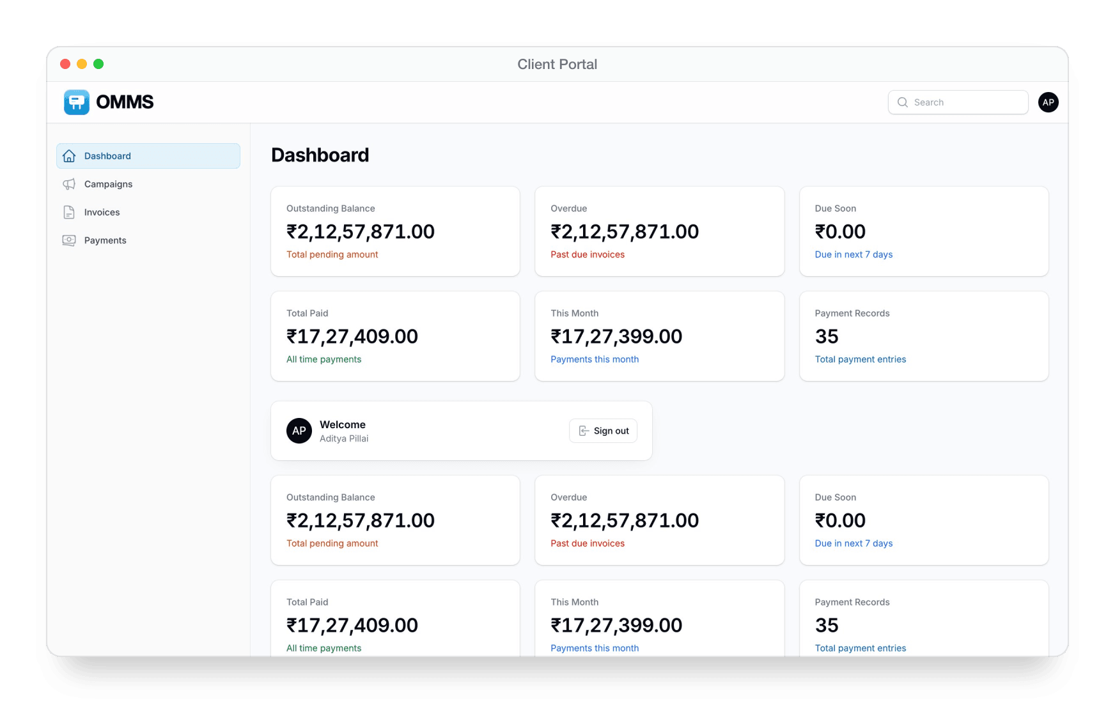
A login for your clients
CLIENT PORTAL
Only their own data
Campaigns, invoices and payments for their company.
Dues at a glance
Outstanding, overdue and paid totals on the home page.
Invoice PDFs
Clients download their own invoices.

Slide 42
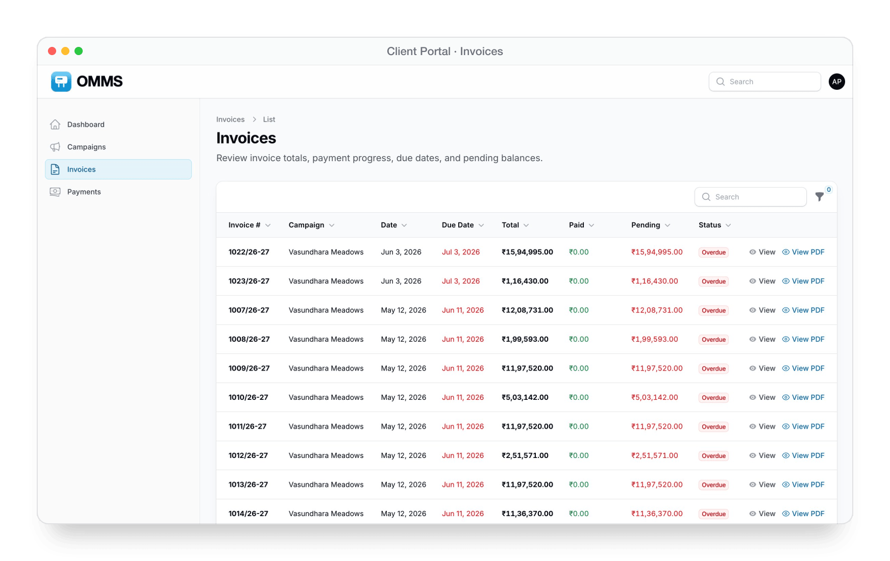
Client portal — Invoices
Totals, payments, due dates and PDFs for the client's own invoices.

Slide 43
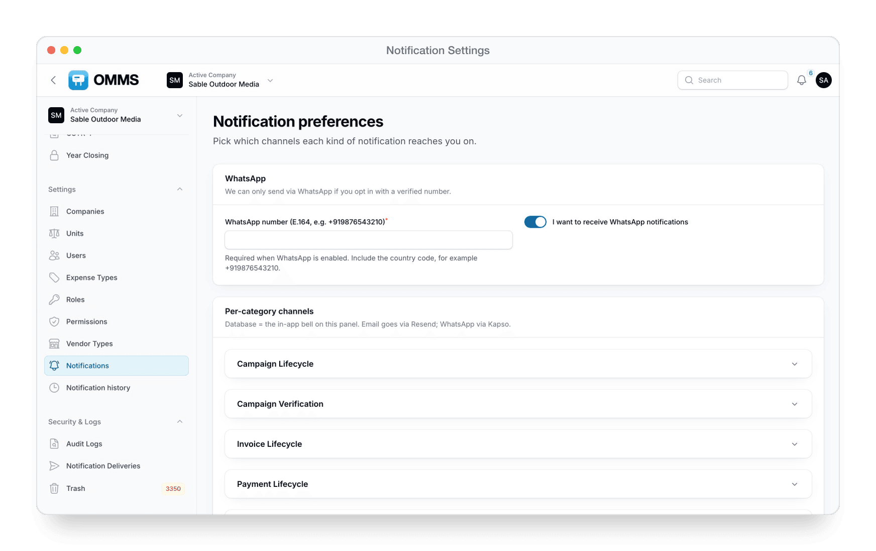
Alerts on the right channel
NOTIFICATIONS
Four channels
In-app bell, email, WhatsApp and mobile push.
Per-category choice
Each person picks channels for each kind of alert.
Daily reminders
Payment reminders, campaign and licence expiry, rent renewals and tasks due today.
Field alerts
Task assigned or updated, and staff going offline.

Slide 44
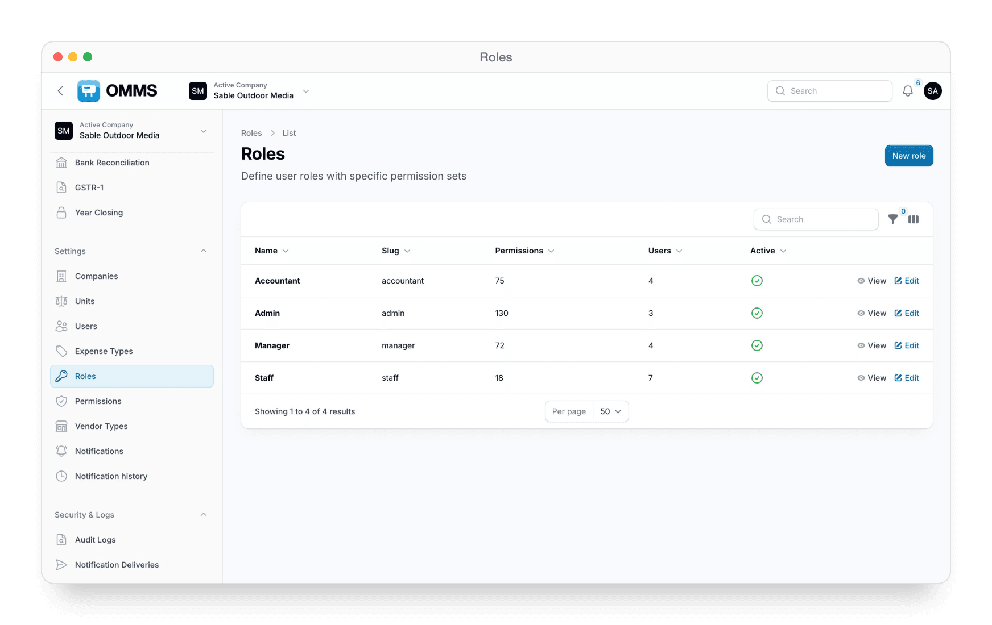
Who can see and change what
SECURITY
Roles
Super Admin, Admin, Manager, Accountant, Staff, Client, Agency and Vendor.
Permissions
Fine-grained permissions per role.
Audit Logs
Who changed what, with old and new values.
Safe deletes
See what a delete affects before you confirm.

Slide 45

Trash
Deleted records by type — restore them, or delete permanently.

Slide 46

Companies, users and masters
SETTINGS
Several companies
Switch between the companies in your group from the top bar.
Users
Tabs by role, bulk activate or deactivate, KYC documents.
Masters
Units, expense types and vendor types.
Exports
Excel on most lists and PDFs for documents.

Slide 47
One system for the office, the field and your clients
Admin panel · Mobile app · Client portal
BOOK A DEMO
rahul@buildnboost.com · +91 79001 51883 (call or WhatsApp) · omms.buildnboost.com

